Slide 2


Accelerator Pack
FCUBS 12.1 - Collection

Slide 3
Agenda
Introduction
Products Features
Collections Approach
Product Parameters

Slide 4
Agenda
Events Covered
Reports and Advices

Slide 5
Collections
Introduction
The collection module is used to support the later stage of a loan cycle related to records of collecting a defaulted loans / Islamic assets / Leasing / Mortgage accounts.
Collections process can be done through the collection department within the bank or it can be outsourced to an external agent

Slide 6
Products Features

Slide 7
Collection- Product Features
Product Features
Collection is a process flow, to track the Collection procedure of all the loans (Assets).
Collection can be done by the collection department of the bank or an external agency
Currently collection is supported for - Consumer Lending ,Islamic Financing Leasing and Mortgages

Slide 8
Collection- Product Features
Product Features
Collection process initiates when the customer does not pay the schedule dues of a loan and the schedule becomes overdue.
This flow ends with the Collection of the overdue amount of the loans from the customer.

Slide 9
Approach

Slide 10
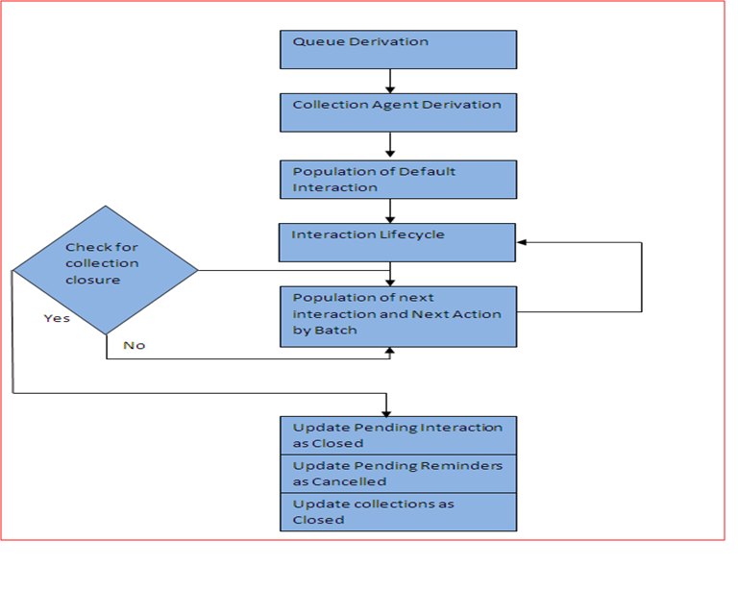
Collection – Process Flow Diagram

Slide 11
Product Parameters

Slide 12
Collection – Product Parameters
Collection Queue assignment – This can be done in batch or manually both modes are supported. Also the change of the Queue assigned by the batch can also be done .
Collection Agent assignment – this can be done batch or manually both modes are supported. Also the change of the Agent assigned by the batch can also be done .
Closure of Collection - If the Overdue amount of the Asset under the collection has gone down to zero then the Collection contract will be closed batch or manually.

Slide 13
Collection – Product Parameters
Module Mapping – CL , LE , MO and CI modules and the respective products in the module can be mapped.
Charge collection – Charge is collected from the customer when he fails to keep up his promise the pay back .
Amendment Options - The following operations are supported for collection contract amendment:
  Parent collection reference number
  Queue Change
  Agent change

Slide 14
Events Covered

Slide 15
Events Covered
Following events are supported
Events | Description
CQAS | Collection Queue Assignment
CASG | Collection Agent Assignment
CNIB | Interaction Booking
CNAP | Interaction Approval
CNRJ | Interaction Rejection
CNEX | Interaction Execution
CNMS | Interaction Reminder Message

Slide 16
Events Covered
Following events are supported
Events | Description
BFEE | Broken promise Penalty Charge
RFEE | Reversal of Broken Promise Fee
CAMD | Collection amendment
CIAM | Collection Interaction amendment
CLOS | Collection Closure
CLST | Collection Status change

Slide 17
Reports and Advices

Slide 18
Reports
  Collection Interaction Details
  Activity Report
  Delinquency Analysis by overdue days
  Account level activity Report
  Delinquency and Activity by each Collection Agent
  Cash Receipts by Collector, Daily and Month to Date

Slide 19
Reports
  Customer Aging Report by Collector (Agent)
  Contacts Results and tickles by Collector (Agent) Summery
  Contacts Results and tickles by Collector (Agent) Detailed Report
  Fee Liquidated to Collection Agent
  Collection Interaction Details
  Activity Report

Slide 20
Advices
  Based on the follow up with the customer , there could be an action item which requires a reminder message(COLL_REMINDER) to be sent . When a customer interaction is recorded , a record will be created in the collection reminder message screen based on the Next action code and mode will be Auto .
  Message can also be generated manually in the screen – CNDCLDRY and also addition text can be added while sending the message

