Slide 2


Accelerator Pack
FCUBS 12.1
Islamic CASA

Slide 3
Program Agenda
Account Class Introduction
Profit Calculation Parameters
Account Features
Amount Blocks
Statements, Advices and Reports

Slide 4
Account Class Introduction

Slide 5
Account Class Introduction
In CASA module, Account Class acts like a product which helps to segregate different types of accounts based on their features.
The Account Class could be defined by comprising the various features that is needed for an account as per the account type selected.
The following are the Account types that is supported in ORACLE FLEXCUBE
  Current Accounts
  Savings Accounts
  Nostro Account

Slide 6
Account Class Parameters
Common features:
Facilities like pass book, cheque book, ATM and debit card that is needed for the account holders.
GL Lines for the customer account balance to get reflected.
Account Statement Format and Parameters.
Dormancy days - post which the accounts are considered as Dormant if there is no transaction performed during these days.

Slide 7
Account Class Parameters
Common features:
  Type of balance the accounts will normally have i.e. either debit/credit.
  Currencies that are allowed to open an account under an account class.
  Customer Categories – Customers allowed to open an account under an account class.
  Document details that is needed to open an account.

Slide 8
Account Class Parameters
Common features:
Currency wise – Minimum balance to open an account, Minimum balance for Profit sharing , ATM Limit, Cash Reserve Ratio, Cash deposit limit for trust account.
Limit tracking and overdraft facilities for current accounts.
Profit Charges flag to enable the Profit Calculation.
Track Accrued IC – If checked, indicates whether accrued Profit in the Profit and Charges module on an account linked to this class, would be considered while computing credit utilization for the account.

Slide 9
Account Class Parameters
Common features:
Posting Allowed – To enable an account for posting transactions.
Profit Calculation Balance Basis- The balance amount that needs to get contributed in the fund for Profit Calculation.
Cash Reserve Ratio to reserve some cash which will not participate in the fund.
RT-Charge Product for Passbook Issuance, if charge needs to be collected for issuance of passbook.
Escrow Transfer Applicable if accounts need to be created for Trust or Project which are allowed for huge debits and credits.

Slide 10
Profit Calculation Parameters

Slide 11
Profit Calculation Parameters
Profit Calculation:
Monthly Average Balance → The day end balances of all the days in a month are added and the resultant value is divided by the number of days in a month.
Month End Balance → The day end balance of the month end date is taken into account.
Minimum Balance → The least balance available during the month will be considered as the balance basis for the purpose of profit sharing.

Slide 12
Profit Calculation Parameters
Profit Calculation:
Combination of Daily Net Balance & Average Balance → This method of calculation is similar to the average balance calculation (as explained above) with the only difference that, whenever the day end balance of an account falls below the minimum balance stipulated for the account, the contribution of that days balance will be taken as “zero” while doing summation for the month.

Slide 13
Example
Transaction Dates | Amount | Balance in Account
Opening Balance in an account as on 1-Mar | 5000 AED | 5000 AED
Amount withdrawn on 8th March | 2000 AED | 3000 AED
Amount deposited on 20th March | 2000 AED | 5000 AED
Minimum Balance required to be maintained for exclusion criteria | 4000 AED | NA

Slide 14
Example
Profit Calculation Basis | Calculation | Amount | Inclusion in Profit Calculation
Monthly Average Balance | ((5000 * 7)+(3000 * 12)+(5000 * 12))/31(days in month) | 4225.806 AED | Y
Month End Balance | Balance on last day of the month | 5000 AED | Y
Average Balance with Minimum Daily Net Balance | ((5000 * 7)+(0*12)+(5000*12))/31 Note: instead of 3000, 0 is taken as 3000 falls below the Minimum Balance 4000 | 3064.516 AED | N
Minimum Balance | Least balance available during the month | 3000 AED | N

Slide 15
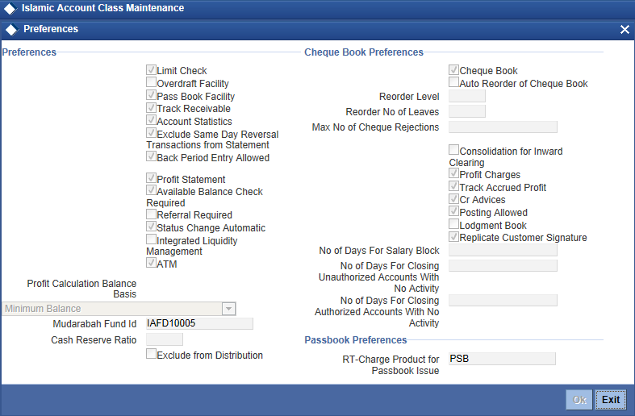
Account Class Preference
Account Class Preference
Menu Path: Customer Accounts →Customer Accounts Maintenance →Account Classes
Fast Path: STDACCLS

Slide 16
Account Features

Slide 17
Account Features
Passbook
Passbook can be issued for an account with or without charges.
A Passbook can have following status at a given point of time:
  Active
  Reissued & Active
  Closed
  User Defined Status

Slide 18
Account Features
Cheque Book
A cheque book can be issued for the Account marked to avail cheque book facility.
A cheque has one of the following status at any given point of time:
  Not Used
  Used
  Rejected
  Stopped
  Cancelled

Slide 19
Stop Payments
A Stop payment could be for a specified period in which case the start and end dates have to be mentioned.
A Stop payment can also be effective till revoked (or for a unspecified period). In such a case only the start date need to be mentioned
A future dated stop payment instruction comes into effect after BOD for that day is run and is effective till the EOD of the expiry date.

Slide 20
Stop Payments
Stop Payment
Stop Payments could be of various types :
Amount Based
Amount Based Stop Payment
Cheque Based Stop Payment
  Single Cheque Stop payment
  Multiple Cheques Stop Payment
(Cheque Amount Mandatory)
Cheque Based
Single Cheque
(Start Cheque No.)
Multiple Cheques
(Cheque Number Mandatory)
(Start & End Cheque Nos.)

Slide 21
Account Features
Contribute to PDM → To decide whether the account will be allowed to contribute to the Fund for Profit Calculation.
Exclude from Distribution → To decide whether account will be considered for Profit distribution i.e. whether account will get any portion of profit or not.
Note : Even if an account is allowed to Contribute in Fund it can be excluded from Profit Distribution. But, if an account is not allowed to contribute to PDM then it must be excluded form Profit Distribution
Fund ID → To specify the fund to which the account will contribute for Profit calculation. This is applicable only if account is included for contribution to PDM.

Slide 22
Account Features
Account Set for Closing →
  It helps to close Saving accounts which are linked to profit module automatically by the system after the profit distribution is done.
  When the user receives any Account closure request, for which the profit distribution is due, user will make the account balance as zero and give the amount to the customer. Profit would be distributed during the next profit period.
  Note : ICPDMBT at EOTI must be configured for automatic Closure.

Slide 23
Account Features
  Mudarabah Sweep
  This facility is available only for the accounts which has overdraft facility. It allows a customer to attach Deposit account to its current/saving account to act as collateral.
  When account is in debit balance then during EOD, system will utilize amount from linked deposits depending upon ‘Order of linkage’.
  When account is in credit balance, then during EOD system will sweep out the utilized amount back to linked deposit (up to extent of available balance of account) depending upon ‘Order of linkage’.
  Auto deposit would be created if the credit balance in the account is more than the minimum balance. If the account moves to debit balance then it will utilize the auto deposit prior to the linked TD.

Slide 24
Amount Blocks

Slide 25
Amount Blocks
Funds in account could be earmarked (or Blocked) for specific purposes.
Amount Block will block the certain amount for the customer account.
They could be placed based on the customer request or at the behest of the Bank.

Slide 26
Statements, Advices and Reports

Slide 27
Statements and Advices
Account Statement Ad-hoc
Ad-hoc MAIL Statement
Interim SWIFT Statement (MT941 and MT942)
Account Statement Mail
Detailed Account Statement (Primary, Secondary, Tertiary)
Summary Account Statement(Primary, Secondary, Tertiary)
Account Statement Swift
Detailed Account Statement MT940 (Primary, Secondary, Tertiary)
Summary Account Statement MT950(Primary, Secondary, Tertiary)

Slide 28
Account Reports
Account Balance List – It list all the accounts with its balance in a particular branch or for the whole bank.
Account Block – It list the Accounts that are blocked in a branch for the period specified in the report.
Account Closure – All accounts that are closed in a particular branch will get listed in this report.

Slide 29
Account Reports
Account Opening – Account Opening confirmation report.
Active Account – It list all the active accounts in a particular branch.
Customer Account – It list the complete details of an account.
Dormant Account – It list all the accounts that moved to dormant after dormancy days.

