Slide 2
Accelerator Pack FCUBS 12.2
CASA

Slide 3
Program Agenda
CASA – Introduction
CASA – Account Classes
CASA – Cheque Book
CASA – Stop Payments
CASA – Amount Blocks
CASA – Spend Analysis
CASA – Interactions
CASA – Statements, Advices and Reports

Slide 4
CASA – Introduction

Slide 5
CASA - Introduction
The CASA module handles Current Accounts and Savings Accounts
Bank User can create Saving or Current accounts for all type of customers (Individual, Corporate or Bank) of bank through the CASA module.
Each account that is defined is identified with account number.
The structure of the account number is based on the account mask maintained at the branch parameters which can be modify by branch level also.

Slide 6
CASA - Introduction
For each Customer Account you can define parameters like:
Account Class
Type of Account – joint or single
Reporting Lines for the account
Currency
Account Limit Etc.,

Slide 7
CASA - Introduction
Common Features:
Saving/Current/Nostro Accounts based on Customer,
With / Without Minimum Balance requirement.
Account Statement generation based on frequency with or without charges.
Cheque books with or without charges.
Accounts can be opened in Currency permitted.
Accounts with or without ATM/Debit card facility.

Slide 8
CASA - Introduction
Common Features:
The account will go dormant if not operated (Based on Dormancy parameter).
Credit Interest and Debit Interest, Formula based and liquidation frequency can be define.Charges would be levied on the following transactions: Cheque book issue, Stop Payment and Ad-hoc Statements etc.
Limit tracking and overdraft facilities are enabled for salary accounts and current accounts.

Slide 9
CASA - Introduction
Common Features:
Customer Account with or without Passbook,
Customer account with Mandatory/Non Mandatory Document check list.
Account with automatic status change, Auto deposit, Provision, Initial Funding.
Account Transfers between branches.
Spend Analysis for Individual Retail Accounts.

Slide 10
CASA – Account Classes

Slide 11
CASA – Account Classes
Customer Accounts are classified into groups called Account Classes.
Examples of account classes:
High Net Worth Individual Savings Bank Accounts,
Corporate Current Accounts
Ordinary Savings Bank Accounts

Slide 12
CASA – Account Classes
For each class, you also define certain common attributes applicable to all accounts in this class, such as:
Facilities granted to the account holders (Pass book, Cheque book, ATM etc.)
The General Ledger lines to which the accounts in this class report
Periodicity and nature of account statements
Dormancy parameter, Initial Funding, Provision, Auto Deposit, Automatic Status Change,
Type of balance the accounts will normally have i.e. either debit/credit.
Many of these attributes can be changed at the level of individual accounts.

Slide 13
CASA – Account Classes
Account Class:
SAVIN : Savings Account Individuals
SAVST : Savings Account Staff
SAVHN : Savings Account Premier: High Net Worth
SAVNR : Saving Account NRI
CACIN : Current Account NRI
CACCR : Current Account Corporate
CACCS : Current Account Salary
SASPND : Savings Account Individuals With Spend Analysis

Slide 14
CASA – Account Classes
Account Class:
PNLSA1 : Notice Accounts with Penalty Interest On Cr Interest
NOSTRO : Nostro Account for Bank
SAVCA : Cover Accounts
SAVCAR : Cover Accounts with Reverse sweepin
LINAC : Line Accounts

Slide 15
CASA – Cheque Book

Slide 16
CASA – Cheque Book
A Cheque book can be issued for the Account marked to avail cheque book facility.
A cheque has one of the following status at any given point of time:
Not Used
Used
Rejected
Stopped
Cancelled

Slide 17
CASA – Stop Payments

Slide 18
CASA – Stop Payments
A Stop payment could be for a specified period in which case the start and end dates have to be mentioned.
A Stop payment can also be effective till revoked ( or for a unspecified period). In such a case only the start date need to be mentioned
A future dated stop payment instruction comes into effect after BOD for that day is run and is effective till the EOD of the expiry date.

Slide 19
CASA – Stop Payments
CASA - Stop Payment
Stop Payments could be of various types :
Amount Based
Amount Based Stop Payment
Cheque Based Stop Payment
Single Cheque Stop payment
Multiple Cheques Stop Payment
(Cheque Amount Mandatory)
Cheque Based
Single Cheque
(Start Cheque No.)
Multiple Cheques
(Cheque Number Mandatory)
(Start & End Cheque Nos.)

Slide 20
CASA – Amount Blocks

Slide 21
CASA – Amount Blocks
Funds in account could be earmarked (or Blocked) for specific purposes
Amount Block will block the certain amount for the customer account.
They could be placed at the direction of the customer or at the behest of the Bank

Slide 22
CASA – Spend Analysis

Slide 23
CASA – Spend Analysis
Spend Analysis is a feature for the Individual Retail Customer Account, to Track all debit entries and to categorize them into particular spend class (Expense Category).
After Categorizing into one category, FLEXCUBE will show Spend Analysis of Customer account in Pie chart, Line Chart and Bar Chart.
To enable Spend Analysis for customer account, Bank user has to enable it at Account Class level.

Slide 24
CASA – Spend Analysis
Spend Analysis Flag will be defaulted from Account Class level to Customer account level.
Once Customer account saved and authorized with spend analysis flag checked, only when FLEXCUBE will track and categorize debit entries of customer account

Slide 25
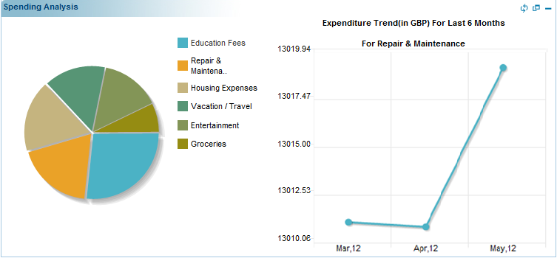
CASA – Spend Analysis
Account Class with Spend Analysis Enabled
Customer Account with Spend Analysis Enabled
All Debit Transaction Tracking and Categorizing By FLEXCUBE

Slide 26
CASA – Interactions

Slide 27
CASA – Interactions
Customer can initiate conversation (Any Query or Complaint) from FLEXCUBE Direct Banking and Bank User can reply to the customer from FLEXCUBE UBS.
Customer can set reminders for themselves.
Bank can initiate different types of Alerts for the customer and customer account via channels like E-Mail, SMS and Dashboard. For example, TD Maturity Alerts, New product offers etc.

Slide 28
CASA – Interactions
Bank can show the Customer memo maintained to the end customer in multiple language and via channels like E-Mail, SMS and Dashboard.
Bank can broadcast message to all customer via Bulletin Board. End Customer can view message on their Dashboard at Customer Portal.

Slide 29
CASA – Statements, Advices and Reports

Slide 30
CASA – Statements and Advices
Account Statement Adhoc
Adhoc MAIL Statement
Consolidated Account Statement
Interim SWIFT Statement (MT941 and MT942)
Account Statement Mail
Detailed Account Statement (Primary, Secondary, Tertiary)
Summary Account Statement(Primary, Secondary, Tertiary)

Slide 31
CASA – Statements and Advices
Account Statement Swift
Detailed Account Statement MT940 (Primary, Secondary, Tertiary)
Summary Account Statement MT950(Primary, Secondary, Tertiary)

Slide 32
CASA –Reports
Daily Account opening Statistics
Account Balance List Reports
Account Statement Report
New Minor Account Report
Account Block and Reason Report
CA Stop Payment Report

