Slide 2
Accelerator Pack FCUBS 14.0.0.0.0
To fill a shape with an image.
Use existing picture box, DO NOT delete and create new picture box.
Right click on the shape.
At the bottom of the submenu select “Format Shape”
Select “Fill” at the top of the “Format Shape” dialog box.
Select “Picture or Texture fill” from the options.
And select “File” under the “Insert from” option.
Navigate to the file you want to use and select “Insert”
On the “Format” tab, in the Size group, click on “Crop to Fill” in the Crop tool and drag the image bounding box to the desired size
DELETE THIS INSTRUCTION NOTE WHEN NOT IN USE
Standing Instructions

Slide 3
Program Agenda
Standing Instructions – Introduction
Standing Instructions – Products
Standing Instruction Advices and Reports

Slide 4
Standing Instructions – Introduction

Slide 5
Introduction
SI module processes the following types of standing instructions:
Standing Payment Order
Standing Collection Order
Account Sweep (Sweep in and Sweep out)
Variable Payment

Slide 6
Standing Instructions – Products

Slide 7
Standing Instructions – Products
SI11 – SI one to one- Payments
The type of standing instruction which is being considered here is Standing Payment order. Under this type of service, one account is debited and another one account of same/different customer is credited.
SI12 – SI one to Many- Payments
Under this type of service, one account of customer is debited and more than one account of any customer account is credited within FLEXCUBE.

Slide 8
Standing Instructions – Products…continued
SI13 – SI Many to one- Payments
Under this type of service, more than one account of customer is debited and another one account of a customer is credited.
SI14 – SI Many to Many – Payments
Under this type of service, more than one account of customer is debited and the amount will be credited into more than one account in FLEXCUBE.

Slide 9
Standing Instructions – Products…continued
SIC1 – SI One to One - Collection
The type of standing instruction which is being considered here is Standing Collection order. Under this type of service, one account is credited and another one account of same/different customer is debited.
VPAY – SI Variable Pay – Payment
This type of standing instruction will have variable amount on each execution. For example Customer required Variable Payment for utility bill payment, where bill amount will be different every time.

Slide 10
Standing Instructions – Products…continued
SPOU – SI One to One – Sweep Out
This type of standing instruction is used when balance of the customer account required to sweep out to the other account at every regular frequency.
SPIN – SI One to One – Sweep In
This type of standing instruction is used when balance of the customer account required to sweep in from the other account at every regular frequency.

Slide 11
Standing Instructions – Products…continued
RBSP – Range Balancing Sweep
This type of standing instruction funds from one account to another account based on the maximum and minimum balance limits
SIIS – SI One to One – Sweep In Intraday
This type of standing instruction is used when balance of the customer account required to sweep in from the other account and instruction can be executed Intraday

Slide 12
Standing Instructions – Products…continued
RBIM – Range Balancing Sweep Intraday
This type of standing instruction funds from one account to another account based on the maximum and minimum balance limits and instruction can be executed Intraday Multiple times
SISO – SI One to One – Sweep Out Intraday
This type of standing instruction is used when balance of the customer account required to sweep in from the other account and instruction can be executed Intraday

Slide 13
Standing Instruction Advices and Reports

Slide 14
Standing Instructions - Advices
EXEC_ADVICE
This advice will be generated on successful execution of SI.
OPEN_ADVICE
This advice will be generated on successful creation of an instruction.
AMEND_ADVICE
This advice will be generated when an existing instruction is amended.

Slide 15
Standing Instructions - Advices
CLOSE_ADVICE`
This advice will be generated on closing an Instruction.
PAYMENT_MESSAGE
This advice will be generated on credit of a payment.
REOPEN_ADVICE
This advice will be generated while reopening a closed Instruction.

Slide 16
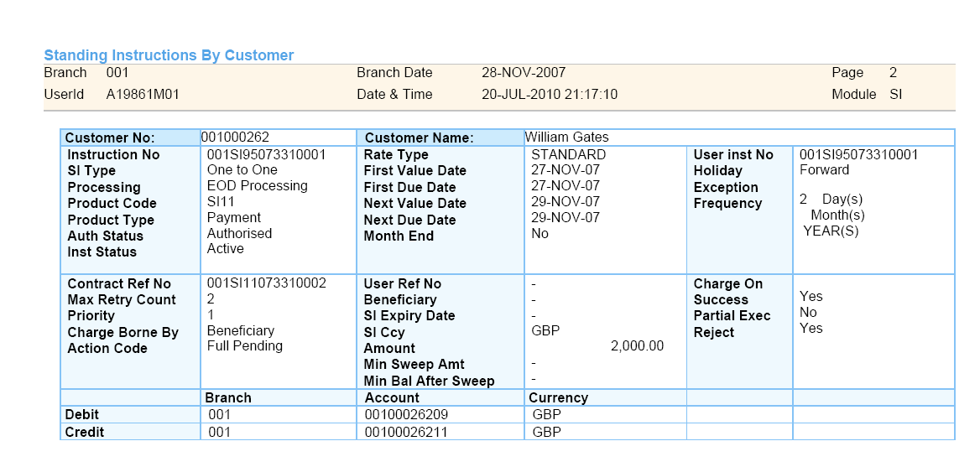
Standing Instructions – Reports
Standing Instructions by customer
This report gives the details of SIs that have been defined for different customers.

Slide 17
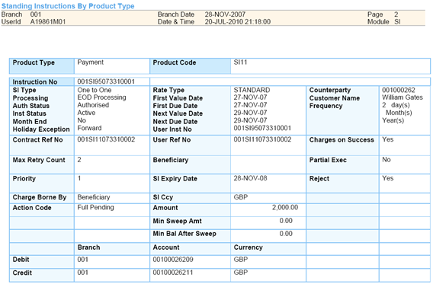
Standing Instructions – Reports
Standing Instructions by product type
This report gives the details of SIs that have been created for different SI products.

Slide 18
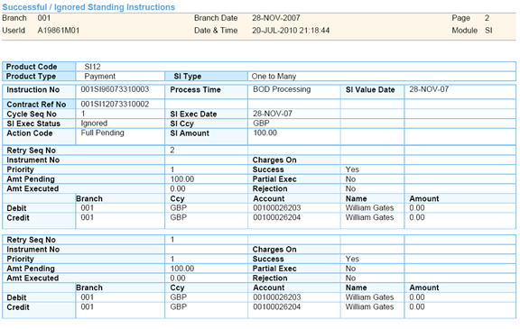
Standing Instructions – Reports
Unsuccessful Standing Instructions for the Day
The report gives details of instructions that were scheduled for the day but were not processed for some reason.

