Slide 2


Accelerator Pack
FCUBS 14.0.0.0.0
SWITCH INTEGRATION GATEWAY

Slide 3
Contents
SWITCH Interface Overview
SWITCH Interface Architecture
SWITCH Interface with FLEXCUBE
Transactions Supported in SWITCH

Slide 4
SWITCH Interface Overview
The Switch Interface gateway overview depicts the pattern in which various switch domain interacts with the FLEXCUBE Application in the switch centric network. .
    ATMs and POS Terminals are connected and communicates with Switch Software using proprietary Message protocol, the format which is transmitted from ATM to switch interface.
    Switch software is also connected with Interchanges like VISA and MasterCard to facilitate the transactions across the banks devices to allow more terminals access to the cards.
    This forwards the transactions to FLEXCUBE switch interface after converting proprietary protocol into ISO8583 protocol message formats.
    FLEXCUBE UBS Switch Interface process all transactions sent by Switch Software by validating each request against FLEXCUBE UBS Database and posts the transactions into FLEXCUBE System.

Slide 5


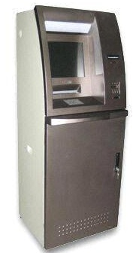
SWITCH Interface Overview – contd…
Terminals
LAYER 1
Interchanges
LAYER 2
SWITCH
FCUBS
POS
KIOSK
Proprietary format Messages
ISO format Messages

Slide 6
SWITCH Software
Switch software functions in 2 layers,
As shown in the picture, In Layer1,
        Switch software maintains the terminals viz., ATM / POS interchange information.
        Maintains the card number to account number linkages.
        Verifies the PIN and the card status
        Receives card transactions from ATM / POS terminals

Slide 7
SWITCH Software – contd…
As part of Layer2,
        The switch software Forwards the transactions to Host Banking Systems like FLEXCUBE
        Converts the received proprietary protocol messages from the terminal into ISO8583 protocol.
        Performs “stand-in” authorization incase of Link to application systems is down.
        Refreshes Account balances from Banking Systems .

Slide 8
Transaction Overview
Given the parties involves viz., Switch, Interchange and FLEXCUBE the transaction flow is facilitated by ISO 8583 protocol.
ISO 8583 protocol helps to exchange information between Acquirer & Issuer.
In this scenario, Acquirer, is the bank that has deployed the terminals [ATM/POS] ,with switch software and interchanges connections established.
Issuer, is typically the bank that issues the cards and responds with Approval / Rejection messages to Acquirers.
The transactions from the Issuer bank perspective could happen in 3 ways and thus it is categorized into ONUS, Remote ONUS and OFF-US.

Slide 9
Business Overview
Following are the typical business flow that happens in banks using ISO8583 Protocol as vehicle :-
  The Plastic cards are issued by the “Issuer Banks” referred as "Issuer".
  The Infrastructure is in place to enable the card transactions
  Acquiring devices ( ATM/POS) installed and connected to Switch software
  Interchanges ( VISA/ MasterCard ) connectivity available with Switch software
  Switch software integrated with Issuing bank software (like FLEXCUBE) using ISO8583 message protocol.
  The Plastic cards will be used at Acquiring point devices installed by Banks referred as "Acquirer“

Slide 10
Business Overview – contd…
  Depending upon the category of the transaction, Switch software will route the transaction either to Issuing bank (FLEXCUBE) i.e. for ONUS or to Interchanges i.e. for remote ON-US and OFF-US.
  Issuing Bank need to respond to the “ISO messages” and provide ISO response to either honor or reject transactions.
  These transactions gets settled with Interchanges or Merchants following next day or later using batch programs
  In some situations, if the communication link goes down between Switch software and Issuer bank, certain Switch has the facility to authorize those transactions These transactions are called as “Stand-in” or STIP or Offline or SAF” transactions.
  SAF transactions are forwarded to Issuer bank once the link is up or processed as batch file upload at Issuer side. For such stand-in purpose, Switch need to get balance refresh regularly from issuing banks.

Slide 11
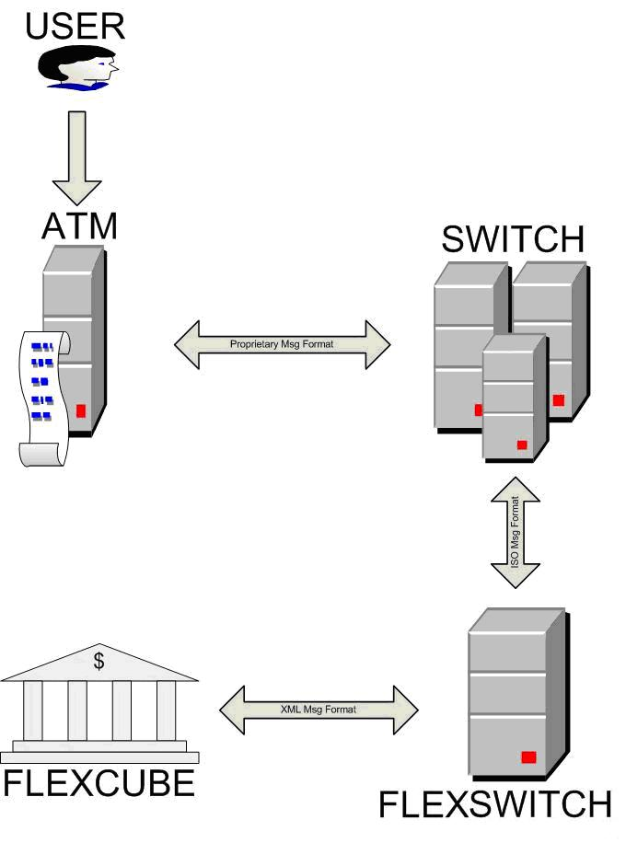
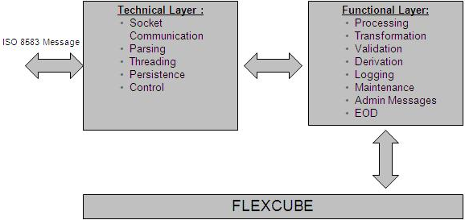
SWIFT Interface Architecture

Slide 12
SWITCH Interface Architecture – contd …
The Interface architecture diagram depicts the components that constitutes the technical and the functional layer for Flexcube to successfully interface with switch software.
Technical layer would be responsible for switch connection and message format handling - catered by ISO 1987/1993/2003 protocol interface.
The ISO8583 messages sent over the socket can have the length indicator either in ASCII / hex packed length format and also functions in 3 versions iz., ISO8583 - 1987, 1993 and 2003 version.
The technical layer address to RAS Requirements i.e Reliable, Available and Scalable.
Functional layer would be responsible for executing functionalities at Flexcube - i.e to switch transactions authorisation and posting into Flexcube.

Slide 13
Technical approach
Switch Interface process is subdivided in to two:
  Communication between SWITCH and Switch Interface - Configuration 1 & Configuration 2
  Communication between Switch Interface and FLEXCUBE
  Configuration 1:
  Communication between SWITCH and interface is through sockets
  SWITCH is client and Interface is server
  The configurable parameters will be maintained in a property file.
  When interface is started it reads the ‘flexswitch.properties’ file and keeps the information in Global shared memory.
  The Socket server will be started as a POJO.
  It creates the maximum number of threads for Reading, Sending and keeps in the thread pool.[ Reader Thread pool, Sender Thread pool]
  This maximum number of threads are configured in ‘flexswitch.properties’ .

Slide 14
Technical approach – contd…
  Interface accept the connection from SWITCH For each connection one reader thread starts reading the socket. A set of sender threads waits on the Sender Memory Q.
  A thread is taken from Reader Thread pool and start receiving the message from socket (say T­­C1Read)
  If the No of bytes parameter is 0 then the ISO message is read as one block. Else the corresponding length of string stream is read from the socket
  When a Message comes , T­­C1Read takes a thread from the Sender Pool (say T­­C1Send) . T­­C1Send picks up the oldest message and processes further
  T­­C1Send picks the message from Sender Memory Q and does file logging.
  T­­C1Send picks then calls the Converter class.
  T­­C1Send send the message to Gateway EJB
  After getting the response from Gateway the response message is passed to converter class to get ISO format and then sent to Socket.
  The same thread writes the response back to the socket and then returns to the pool.

Slide 15
Technical approach – contd…
Communication between SWITCH and Switch Interface
  Configuration 2 :
  Communication between SWITCH and interface is through sockets
  The interface can be configured to call gateway in an asynchronous fashion also.
  In this mode the T­­C1Send sends the message to Gateway In MQ.
  Before sending the message in to MQ T­C1Send will set the Client Id in the message ID.
  Client id is a combination of port number of the connection and the system timestamp, and a random number thus making it unique per connection.
  A hash map is created with this Client Id as key and Socket Object of this connection as value.
  Response will be received in the Gateway Out MQ.
  To write the message back to the socket threads from the Receiver Thread Pool will have to be used. This Receiver Thread Pool will be initialized on start up.
  Receiving thread (T­­C1Receive) polls the response from GW out MQ (FIFO method).
  The response message is passed to converter class to get ISO format. It identifies the Client Id of the message from the correlation ID and using the hash map obtains the socket object and writes the response back to this object and then continues to poll the Output MQ.

Slide 16
Technical approach – contd…
Communication between Switch Interface and FLEXCUBE
  Communication between Switch Interface and gateway is using the Gateway EJB/MDB that is exposed to the outside world for communication. GW will operate with its own transaction control. Any failure after receiving a response from GW will be handled as a timeout.

Slide 17
Technical approach – contd…
Switch Interface responsibilities
  Accept the socket connection/s from SWITCH
  Read the ISO message from socket
  Write the ISO message into a Memory Queue
  Read the ISO message from Queue and convert it into GW XML
  Send the request XML message to Gateway
  Accept the gateway response XML
  Convert gateway response XML to ISO response message
  Send the ISO response back to SWITCH through socket

Slide 18
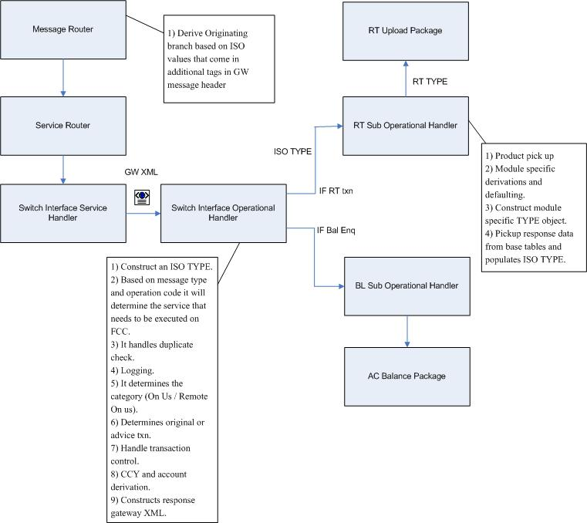
Functional Approach

Slide 19
Functional Approach – contd…
  The source will be FLEXSWITCH.
  The originating branch is derived in the messaging schema using the Issuer BIN and Acquirer BIN. These two values are received in the additional parameters tag in the header. The originating branch is used as the BRANCH tag in the header.
  The service, operation received will be FCUBSSwitchService, SwitchTransaction.
  A new gateway service handler for FCUBSSwitchService will be created.
  This new service will have a XSD. The XSD will have all the ISO fields as individual tags.
  There will be an operation handler (switch interface operation handler) that will parse the incoming GW XML and construct an ISO TYPE object . Depending on the ISO version the fields from the GW XML will be mapped to fields in the ISO TYPE. The ISO version will be defined in Switch Integration Parameter table. Based on message class and operation code it will determine the service that needs to be executed on FLEXCUBE and calls the corresponding package (explained in the next point). It handles duplicate check (by logging into a table). It determines the category (On Us / Remote On us).

Slide 20
Functional Approach – contd…
  For each service that will be used by ATM/POS the corresponding operation handler will be duplicated and tailored to meet the ATM/POS requirements
  The response message class is determined in the switch interface operation handler. Using the ISO TYPE that it receives it builds the response XML.
  Product maintenance and upload package will be enhanced to meet new requirements

Slide 21
Customer Specific Maintenance
  User needs to Follow the Following set of Maintenance
    Customer Account Creation
    Card Customer
    Card Account Maintenance

Slide 22
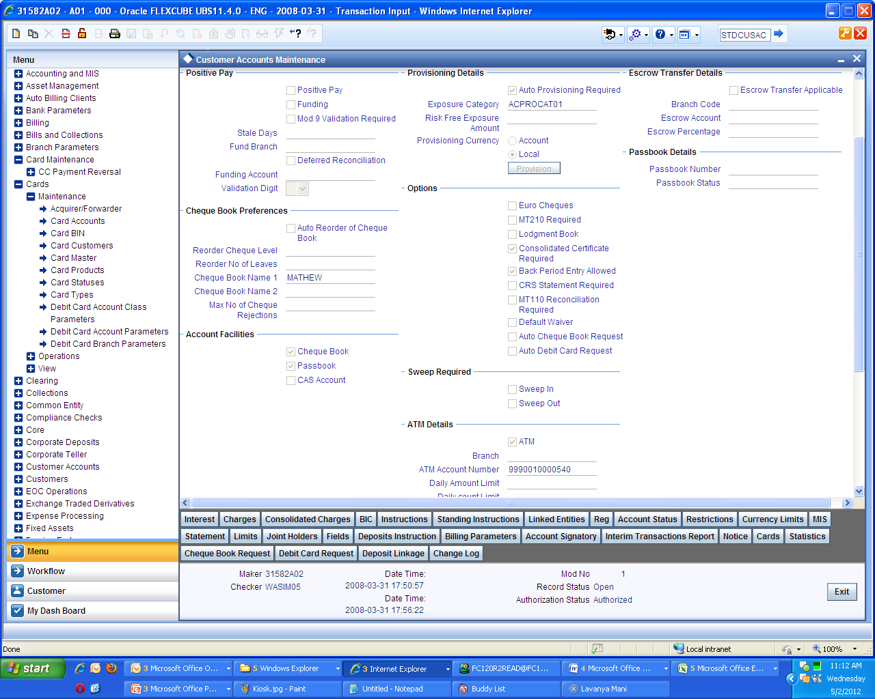
Customer Specific Maintenance – contd …
Customer Account Creation
Create Customer Account for ATM/IVR and POS Operations
The Checkbox “ATM” under ‘Preference’ tab should be Checked along with ATM Account number.

Slide 23
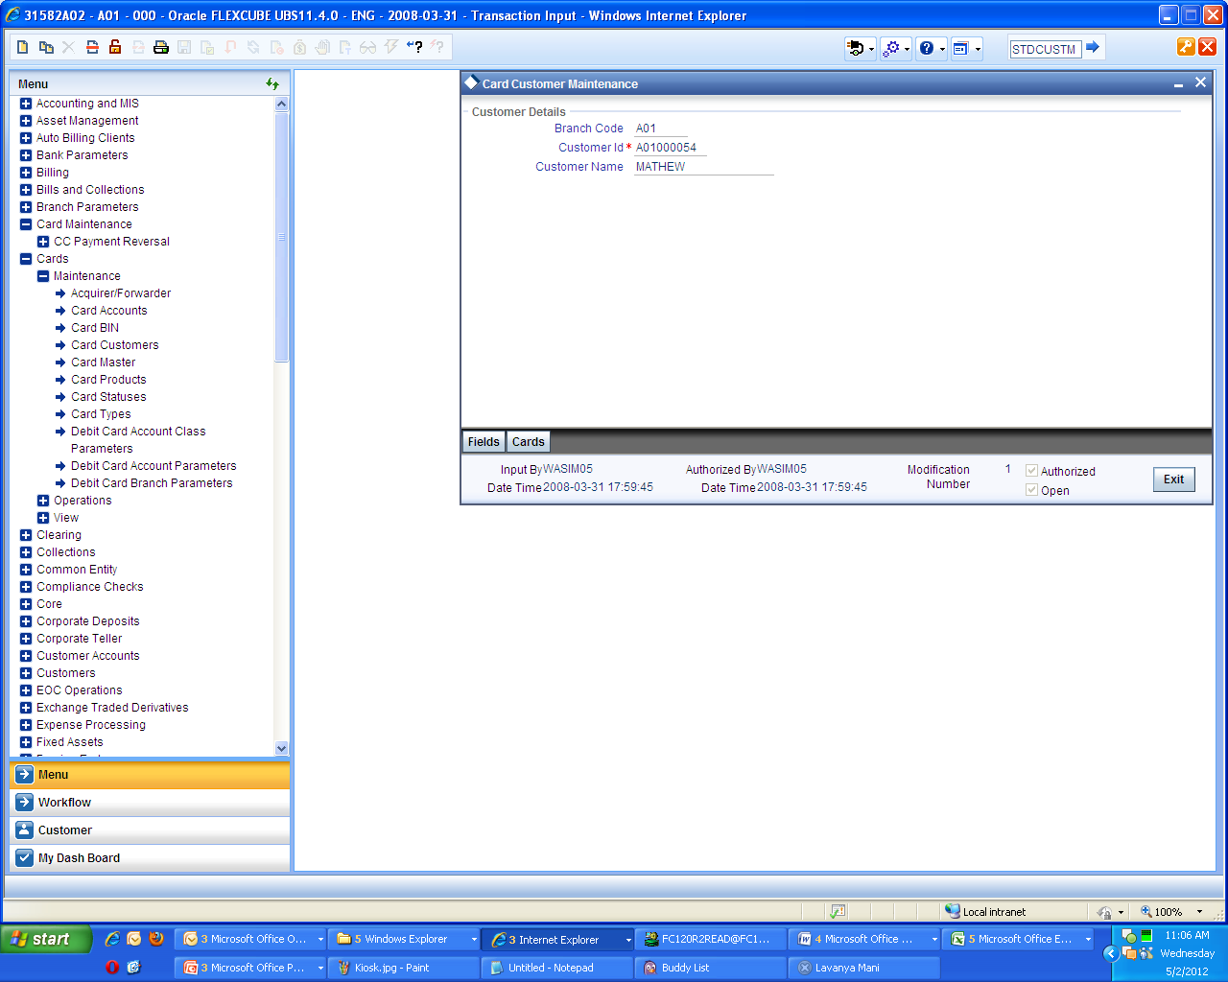
Customer Specific Maintenance – contd …
Card Customer
Create Card Customer . User needs to create a Card Customer which is identified as a Customer who are Eligible to have cards.

Slide 24
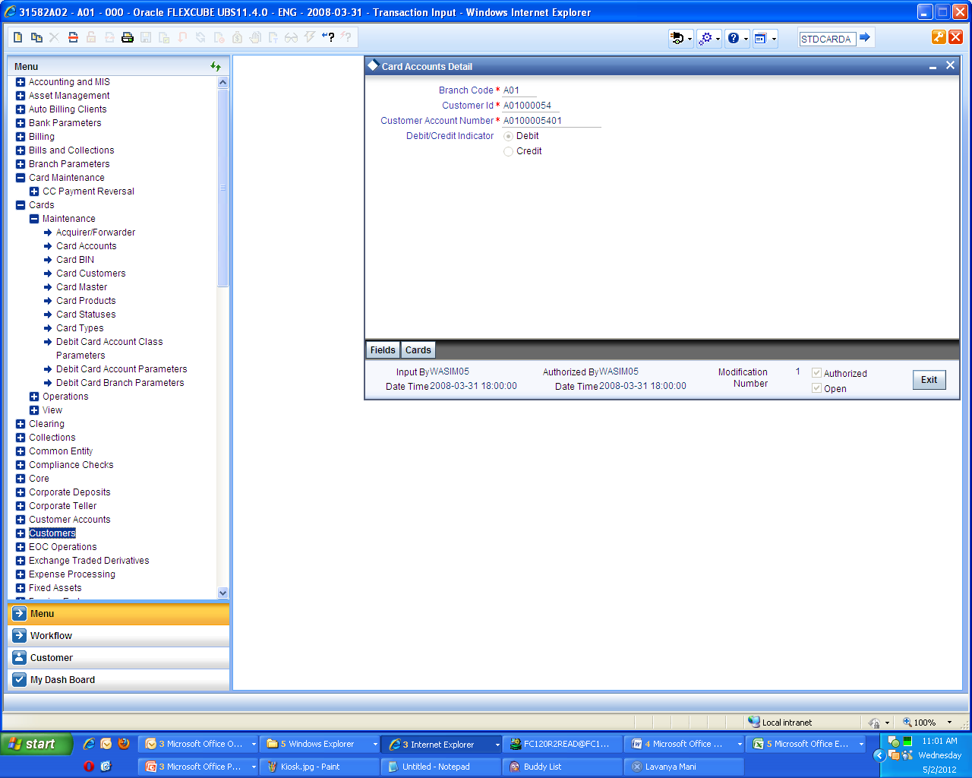
Customer Specific Maintenance – contd …
Card Account Maintenance
Create Card Account for a Customer . User needs to select the type of Card for the ‘Card Customer’ which is Mapped to a Customer Account

Slide 25
Bank Specific Maintenance
Bank Specific Maintenance can be Divided into two parts :-
    General Maintenance
    Card Specific Maintenance

Slide 26
Bank Specific Maintenance – contd …
General Maintenance
User needs to follow the following set of Maintenance:-
    Country Maintenance
    Currency Maintenance
    Inter-Branch Parameter maintenance

Slide 27
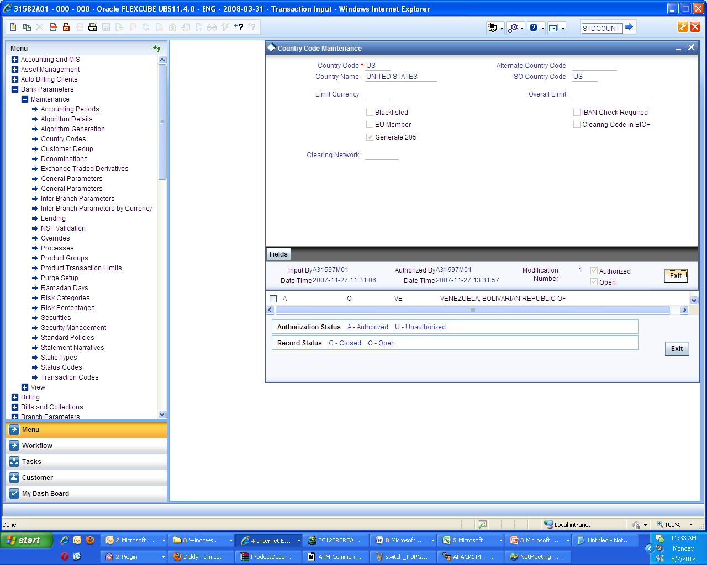
Bank Specific Maintenance – contd …
Country Maintenance
User needs to Maintain Country as currency needs t o be maintained for Bank which in turn needs to be Linked with the Country

Slide 28
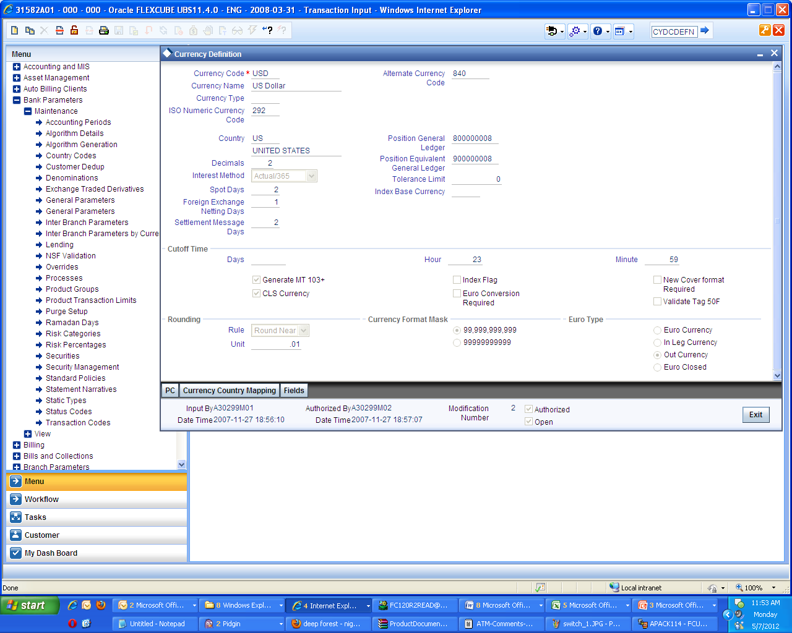
Bank Specific Maintenance – contd …
Currency Maintenance
User needs to Maintain Currency along with ISO Numeric Code .

Slide 29
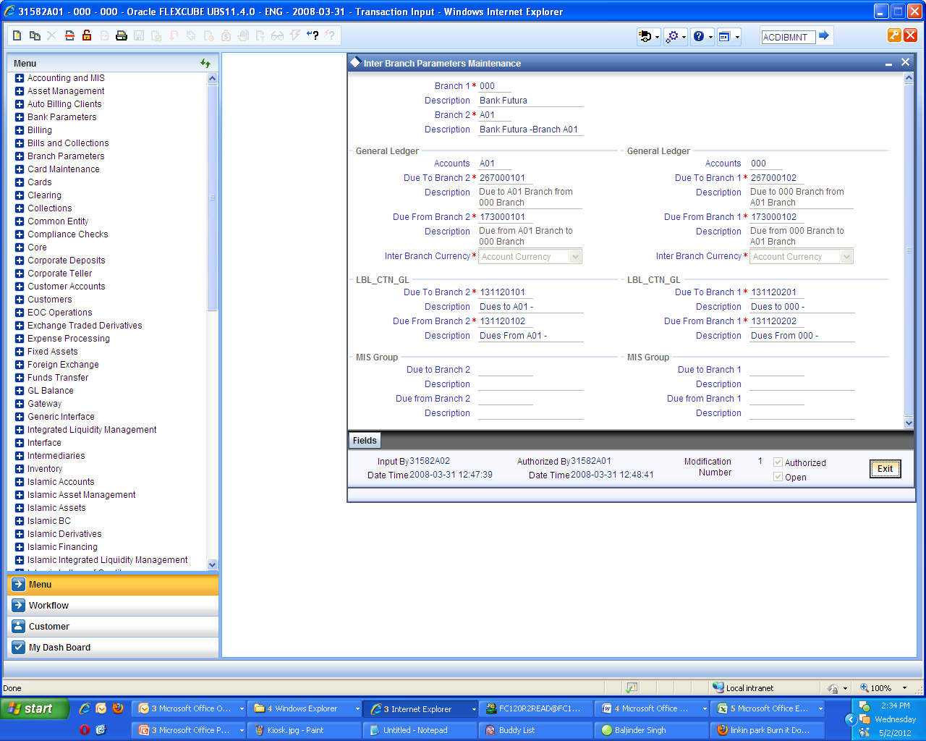
Bank Specific Maintenance – contd …
Inter-Branch Parameter maintenance
User needs to Maintain ‘Inter-Branch Parameter’. The inter- branch parameter is maintained for ATM/IVR and POS transactions between Head office and a Branch.

Slide 30
Bank Specific Maintenance – contd …
Card Maintenance
User needs to follow the following set of Maintenance : -
  Card Status
  Card Bin
  Card Type
  Card Product
  Card Master Maintenance

Slide 31
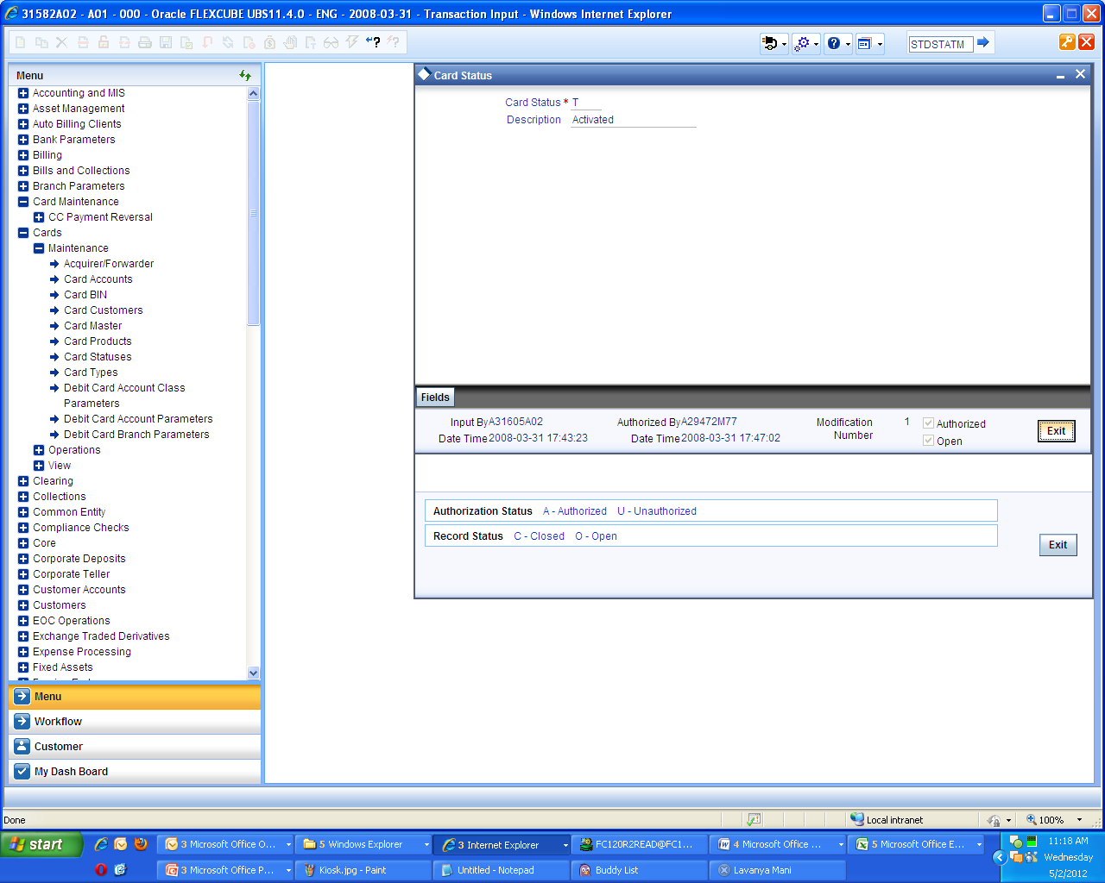
Bank Specific Maintenance – contd …
Card Status
User needs to maintain Card Statuses . Status can be ‘Issued’ , ‘Activated’ , ‘Blocked’ etc.

Slide 32
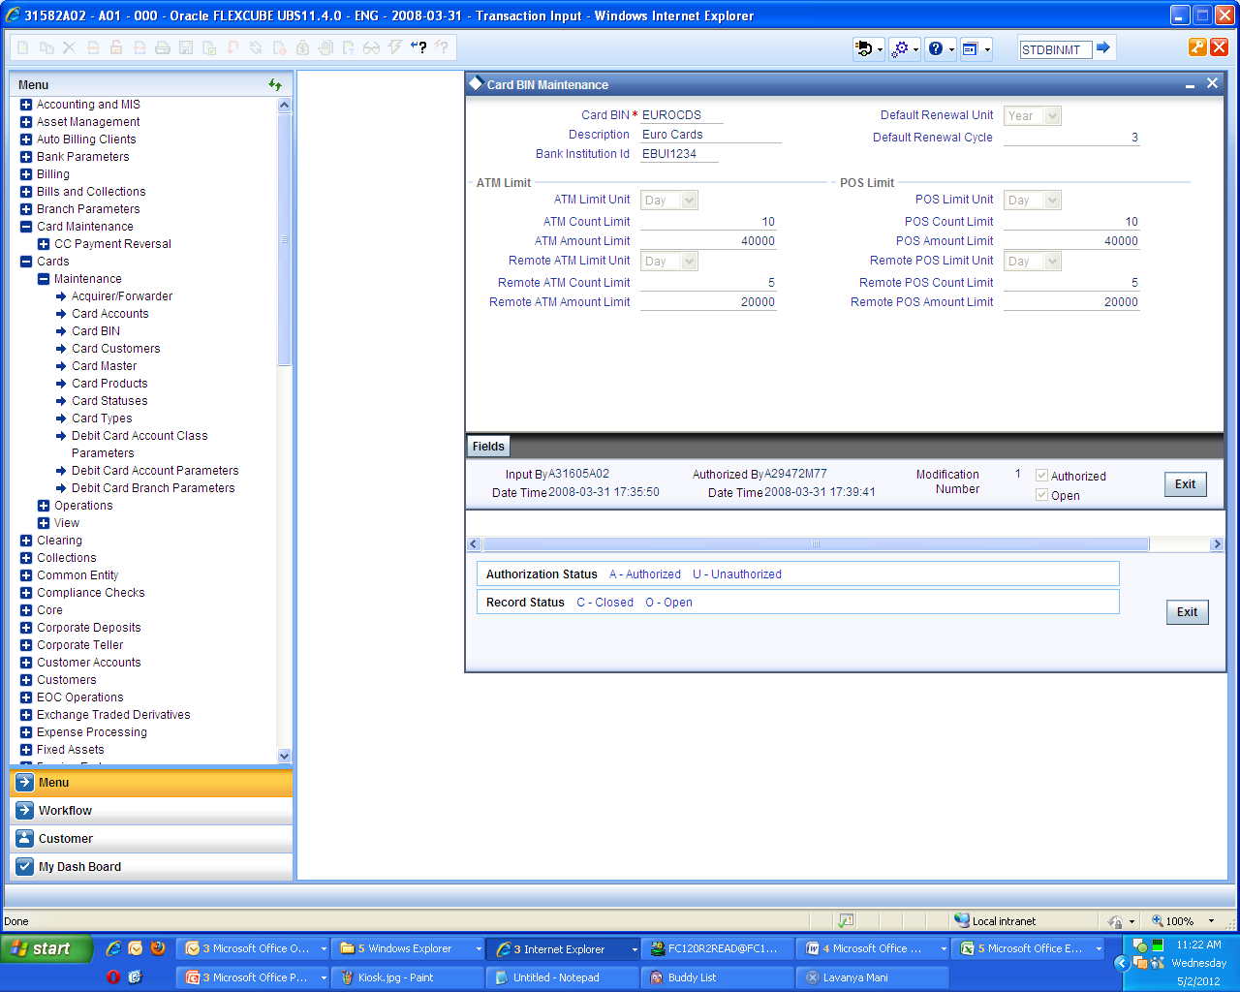
Bank Specific Maintenance – contd …
Card BIN Maintenance
User needs to Maintain Card BIN . Card BIN hold important details like “ATM count limit” . “POS Amount limit” etc

Slide 33
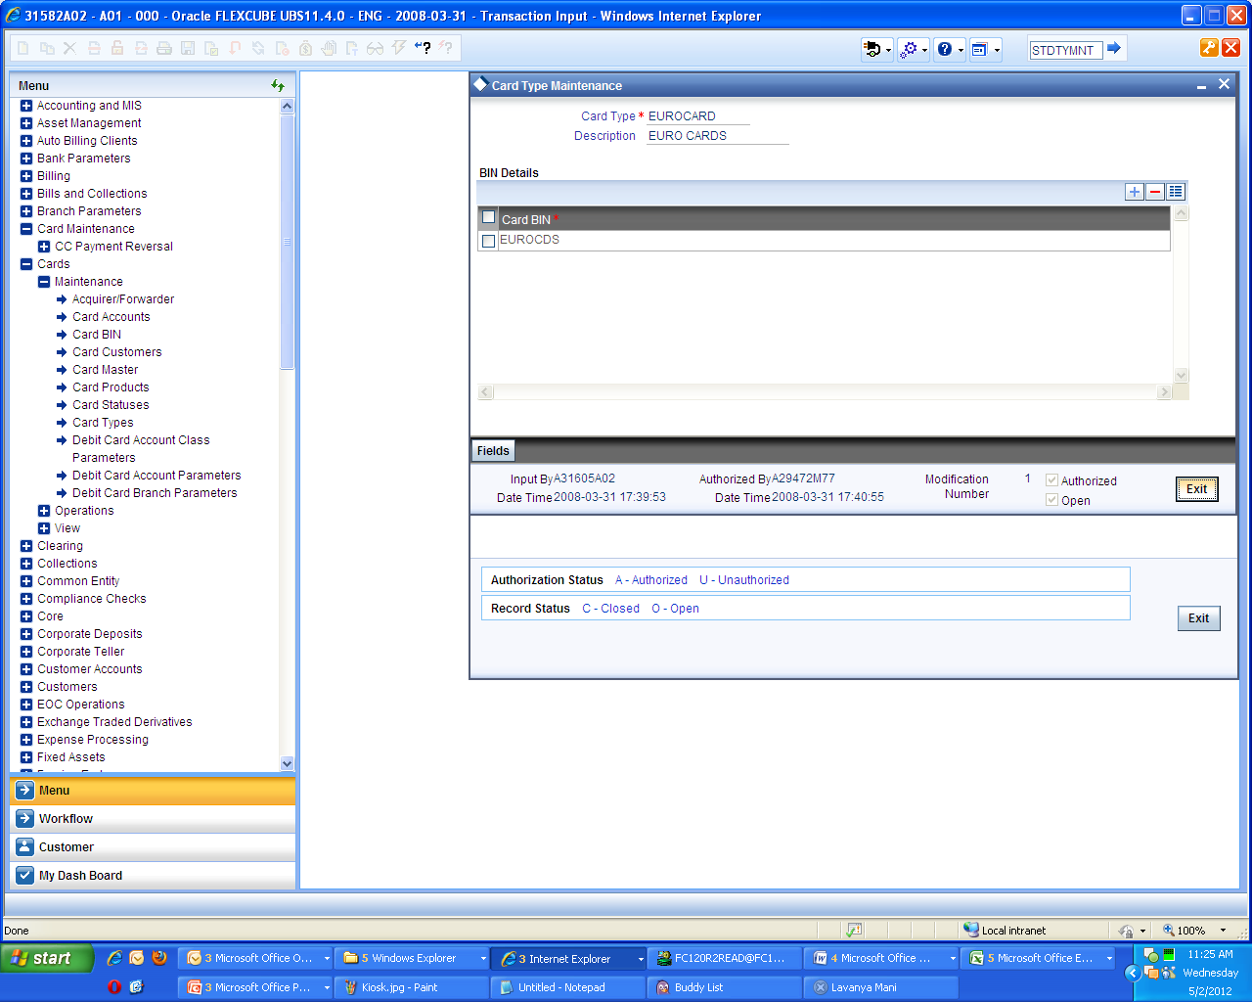
Bank Specific Maintenance – contd …
Card Type Maintenance
User needs to Maintain Card Types . Card types denotes the types of cards that the bank can provide its Customers , Card types can be unique from one another. The uniqueness is provided in its characteristics like “ATM withdrawal amount” , “No. of POS transactions” etc which are provided in Card BIN , to which the Card type is linked

Slide 34
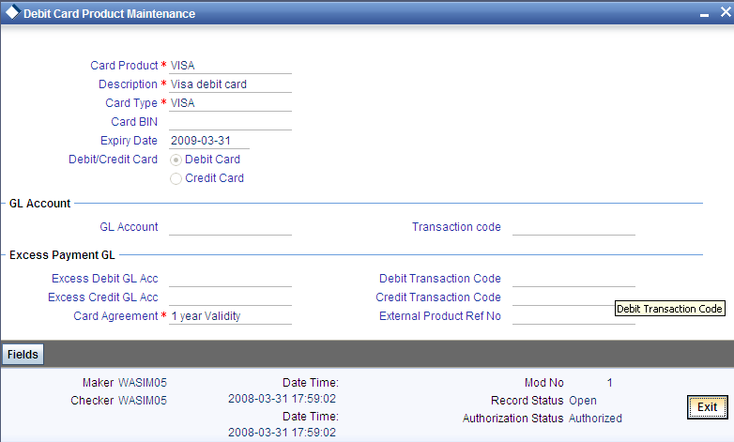
Bank Specific Maintenance – contd …
Card Product Maintenance
User needs to Maintain Card Products .

Slide 35
Linkage Between Card specific Maintenance and Customer Maintenace
Customer
Card Statuses
Customer Account
Card BIN
Card Customer
Card Types
Card Customer Account
Card Product
CARD MASTER
35
| Copyright © 2015, Oracle and/or its affiliates. All rights reserved.
Confidential – Oracle internal

Slide 36
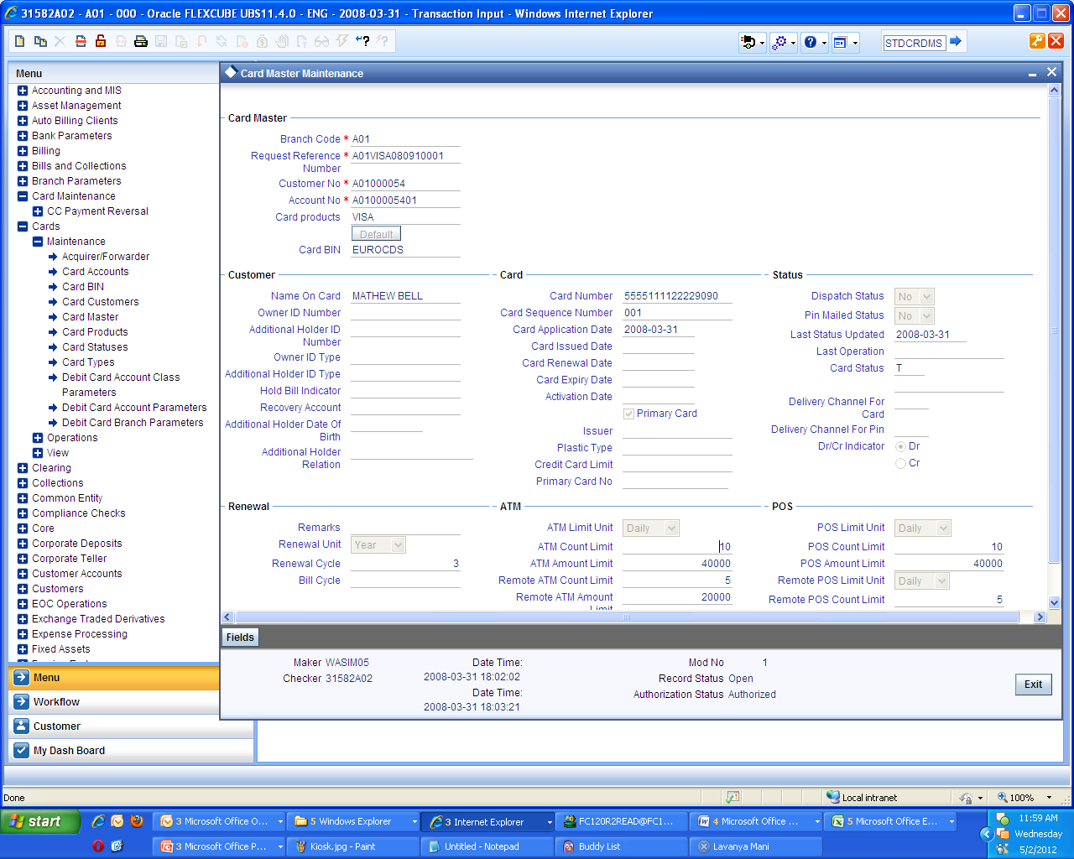
Bank Specific Maintenance – Card Maintenance
Card Master Maintenance
User needs to Maintain Card Master Maintenance . Using this maintenance the Customer Account along with the customer is Linked with the Card and Card Specific maintenance. User needs to Select “Card Status” as “Activated”

Slide 37
Liability Maintenance
Every customer of bank who enjoys credit facilities should be assigned or linked to a Liability Code category. Several customers can be linked to the same Liability Code. Liability linkage can be in two ways.
Single Liability linked to multiple customers (i.e. a Customer Group)
Single Liability linked to only one customer

Slide 38
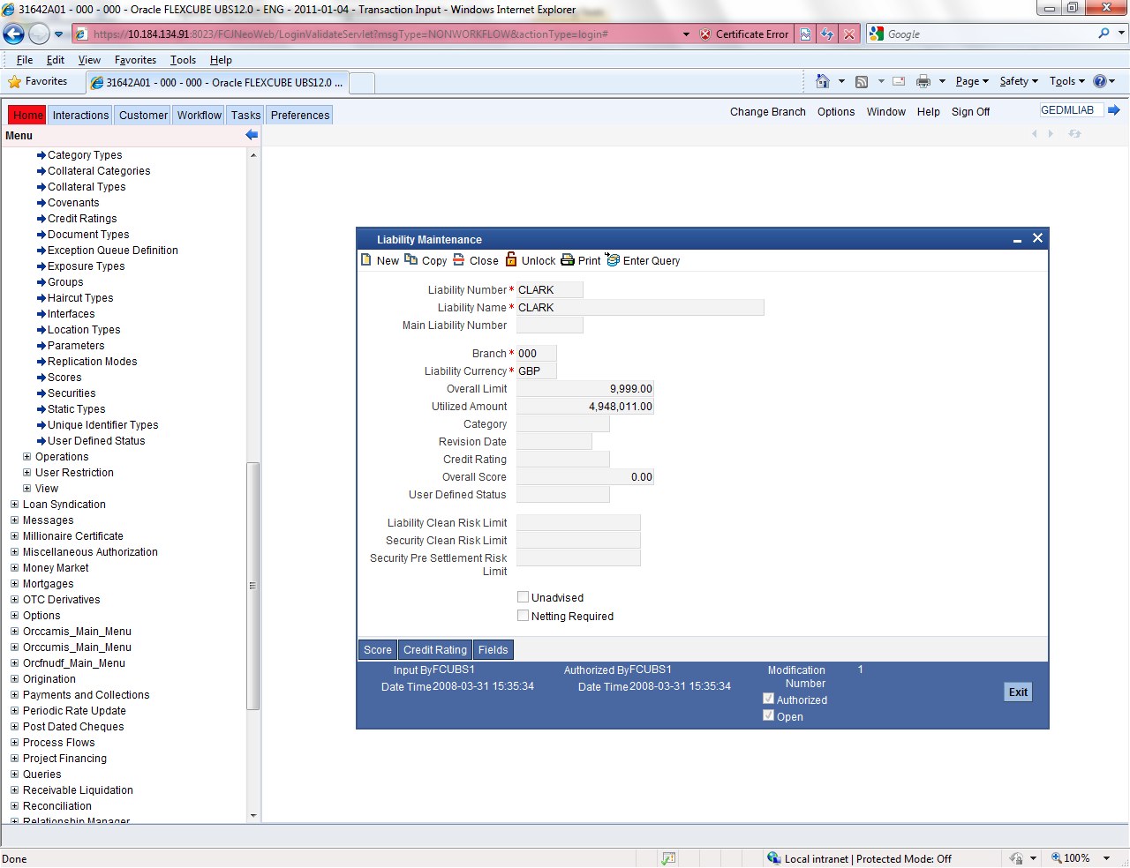
User Defined Status
Path : Limits and Collaterals-> Operations -> Liability Input
Fast Path : GEDMLIAB

Slide 39
Interface Specific Maintenance
Configurable in Interface(flexswitch.properties)
  Port numbers which is exposed to SWITCH (ATM and POS)
  Connecting POS and ATMs in same or different ports
  Bitmap type (ASCII/Binary) configurable.
  Maximum number of connections from SWITCH
  Maximum number of threads or reading from socket
  Maximum number of threads for calling gateway service.
  Logging required for debug and socket message.
  Log file path and file names
  ISO Version for the purpose of picking up the corresponding config file.
  RMI information for calling FLEXCUBE Gateway
  Head office branch code
  User id of interface to communicate to FLEXCUBE
  No of bytes that indicate length

Slide 40
Interface Specific Maintenance – contd…
User needs to follow the following set of Maintenance : -
    Upload Source Maintenance
    External System Maintenance
    External System Function Maintenance
    Upload Source Preferences maintenances
    User Maintenance
    Retail Teller Product Maintenance
    ARC Maintenance
    ATM/Debit Card FCC Account Mapping
    Network Details
    Terminal Details
    Product Type Maintenance
    Process Code Mapping

Slide 41
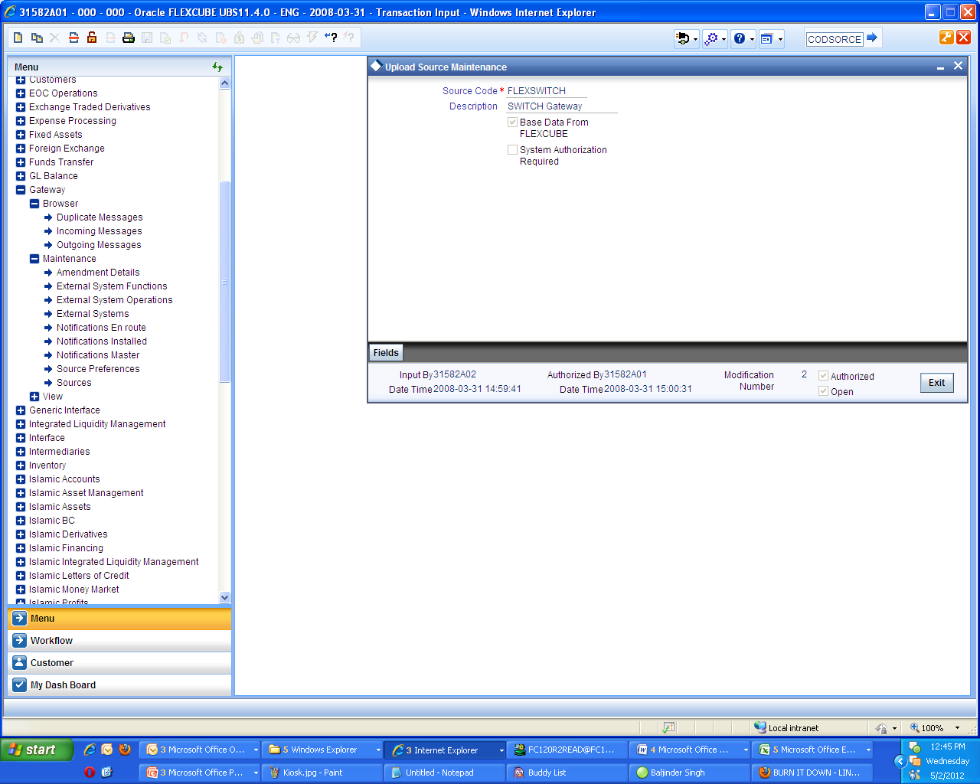
Interface Specific Maintenance – contd …
Upload Source Maintenance
User needs to Maintain External Source as “FLEXSWITCH” which is External system for ATM and POS transaction.

Slide 42
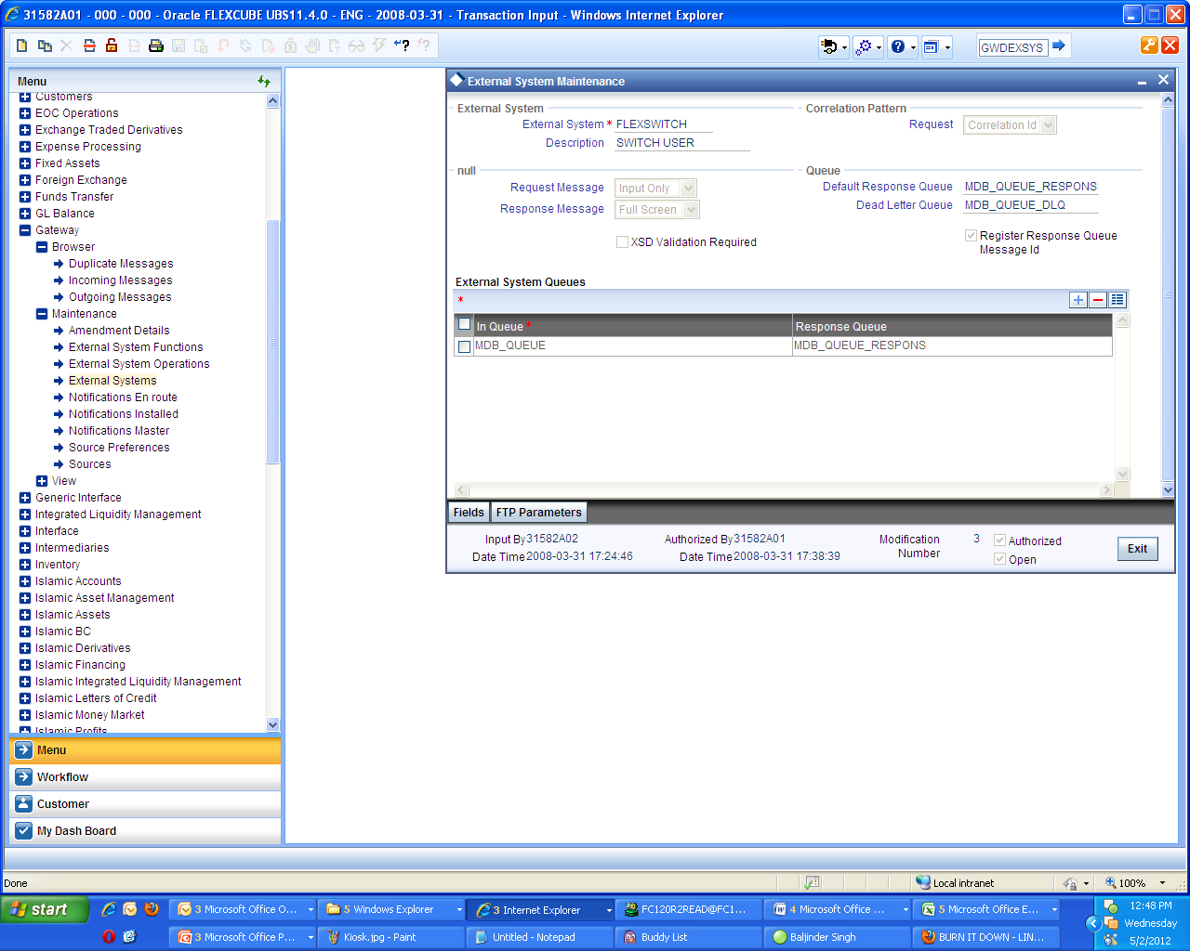
Interface Specific Maintenance – contd …
External System Maintenance
User needs to Maintain External System as “FLEXSWITCH” which is External system for ATM and POS transaction.
User must provide Queues (Default Response queue , Dead letter Queue , In Queue , Response Queue) in accordance to the Schema Setup

Slide 43
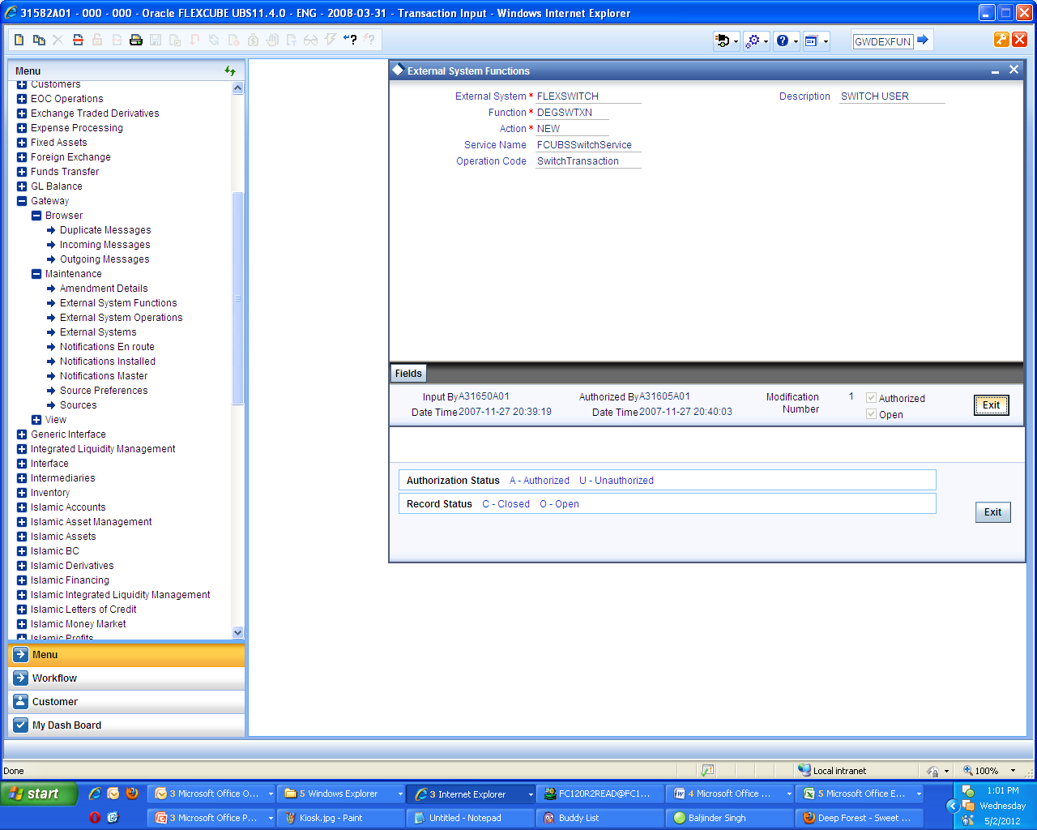
Interface Specific Maintenance – contd …
External System Function Maintenance
User needs to Maintain External System Function as “FLEXSWITCH.
User must External System to ‘Service Name’ named ‘FCUBSSwitchService’ and ‘Function’ named ‘GWDEXFUN’.

Slide 44
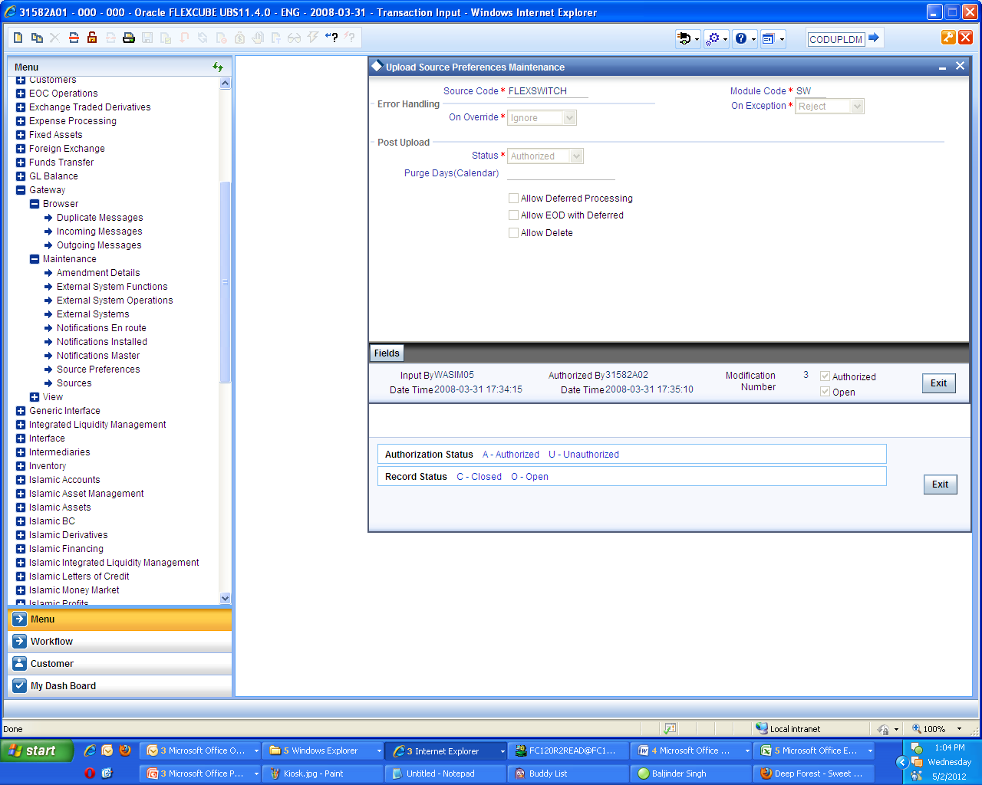
Interface Specific Maintenance – contd …
Upload Source Preferences maintenances
User needs to Maintain Upload Source Preferences as “FLEXSWITCH.
With the help of the upload source preferences maintenances screen map the External system with the module ‘Switch’.

Slide 45
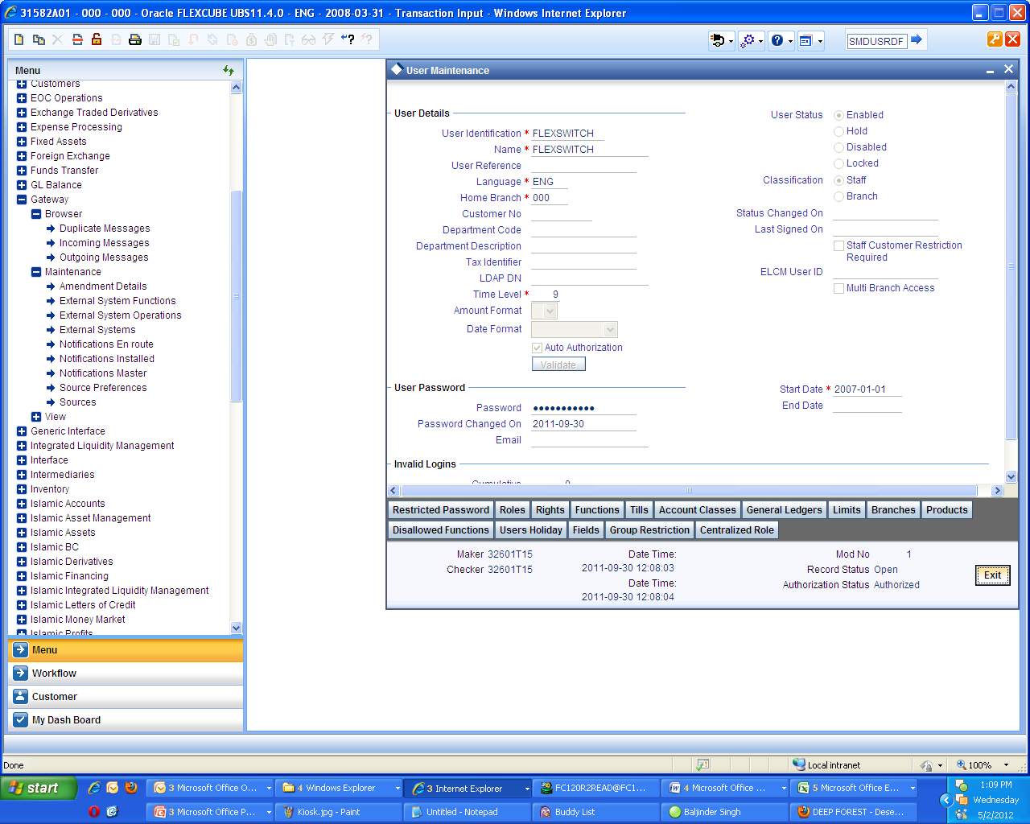
Interface Specific Maintenance – contd …
User Maintenance
User needs to Maintain User as “FLEXSWITCH.
The User need to have ‘Auto Authorize’ facility.

Slide 46
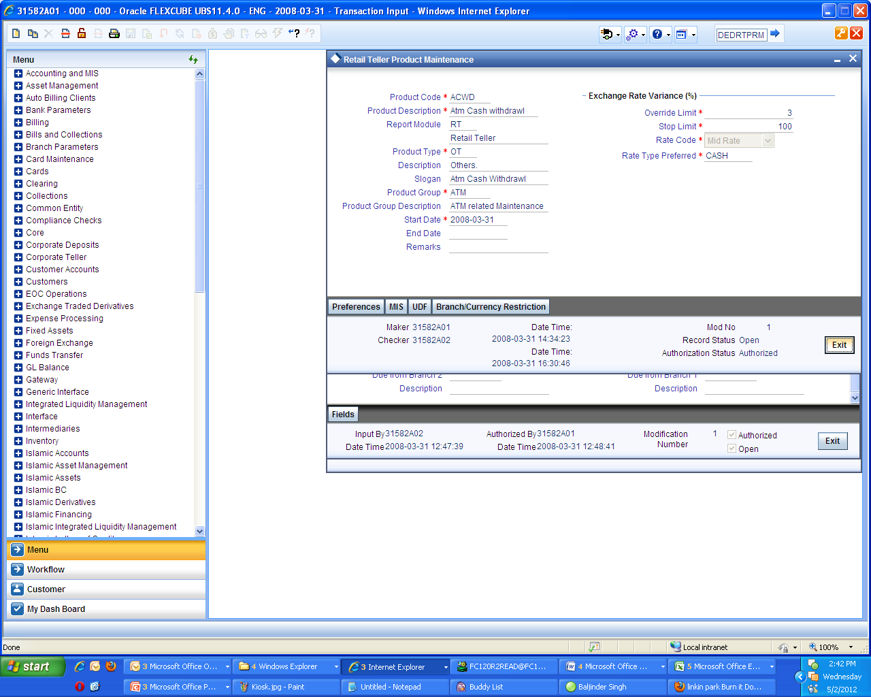
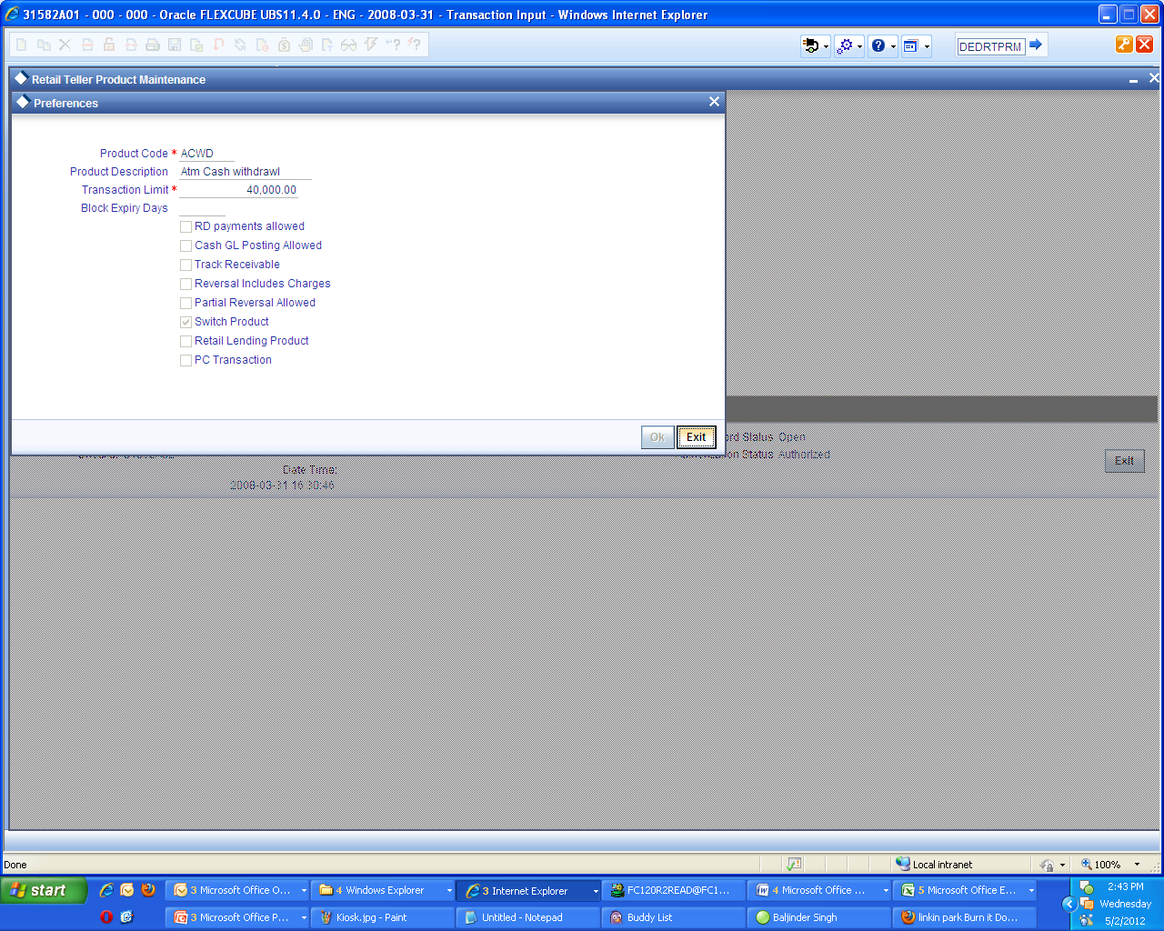
Interface Specific Maintenance – contd …
Retail Teller Product Maintenance
User needs to Maintain ‘Retail Teller Product’. This must be maintained for maintained for each and every type of transactions such as Cash withdrawal, Cash deposit, POS transaction, Balance enquiry, Mini statement etc,
In the “Preferences” tab of the “Retail Teller Product Maintenance” it is necessary to check the box ‘Switch product’, so that the product can be fetched in the “Switch Product” mapping screen

Slide 47
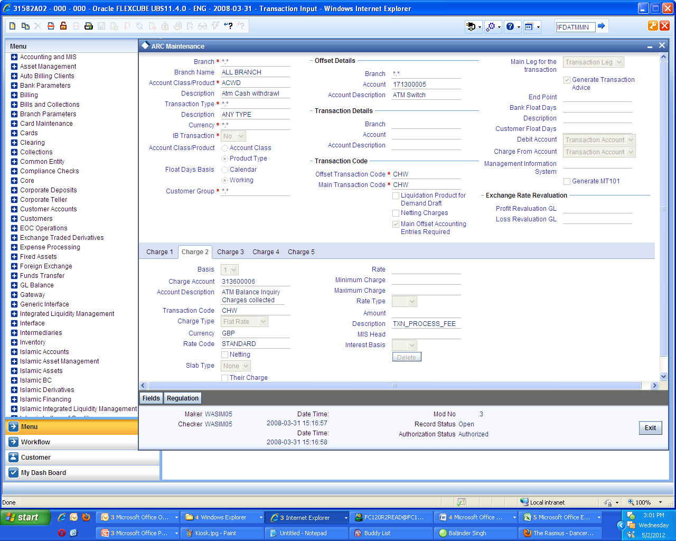
Interface Specific Maintenance – contd …
ARC Maintenance
User needs to Maintain ‘ARC’. This must be maintained for maintained for each and every type of transactions such as ‘Cash withdrawal’, ‘Cash deposit’, ‘POS transaction’, ‘Balance enquiry’, ‘Mini statement’ etc . This maintenance is used to collect charges for a particular set of ATM operations like “Balance Enquiry” charges etc.
Description as “TXN_FEE” and “TXN_PROCESS_FEE” must be maintained under “Charge1” and “Charge2” tab respectively.

Slide 48
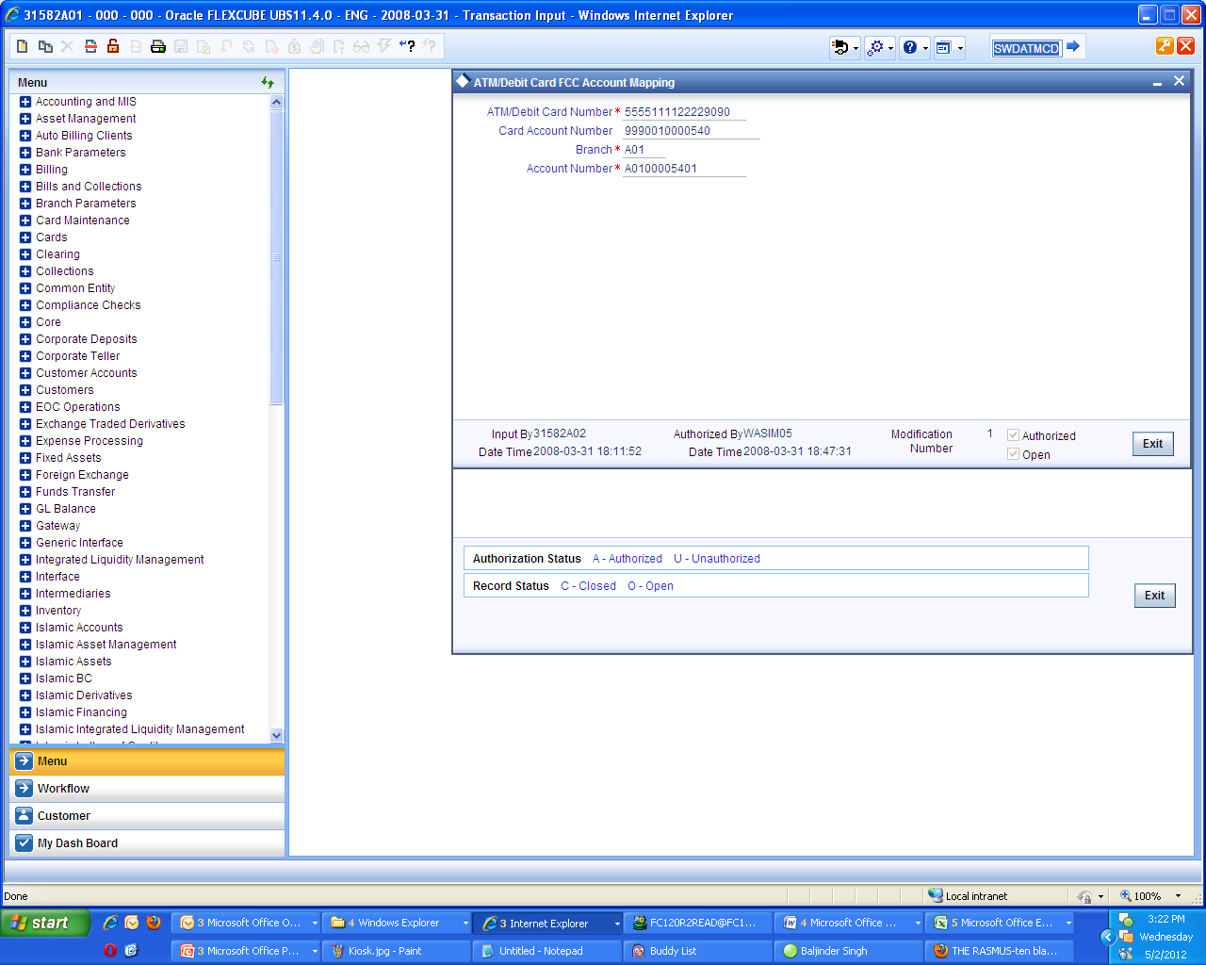
Interface Specific Maintenance – contd …
ATM/Debit Card FCC Account Mapping
User needs to Maintain ‘ATM/Debit Card FCC Account Mapping’ in order to map “ATM/Debit Card number” ,” Card Account Number” and “Customer Account Number”.

Slide 49
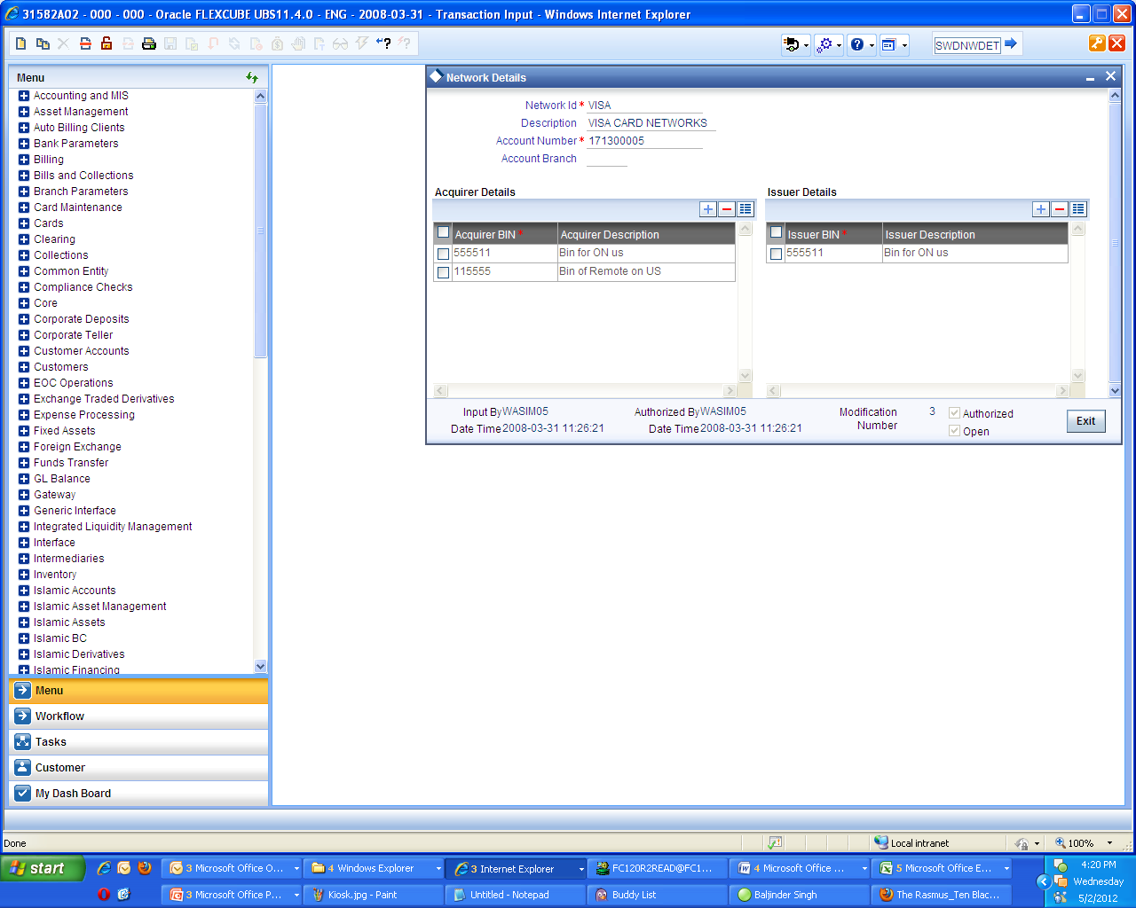
Interface Specific Maintenance – contd …
Network Details
User needs to Maintain ‘Network Details’ in order to map “Issuer” and “Acquirer” with their BIN. This is required as ATM/POS transaction interacts with Networks with the help of this BIN

Slide 50
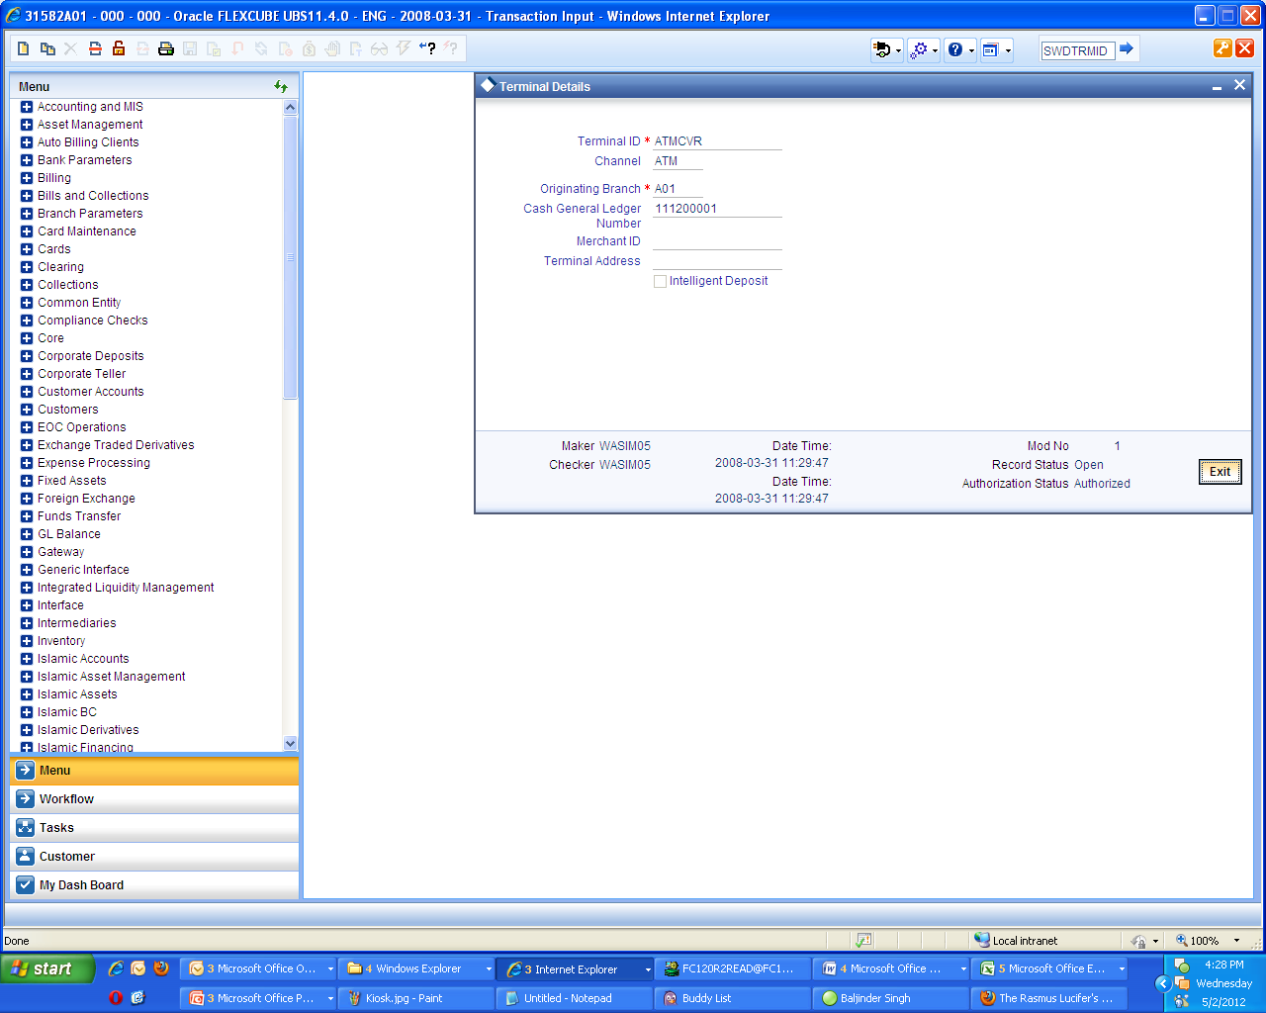
Interface Specific Maintenance – contd …
Terminal Details
User needs to Maintain ‘Terminal Details’. The term ‘Terminal’ is used to refers to an external entity from which a Switch Transactions either originates or Terminates. Typically , a Terminal is a ATM Dispenser machine or a POS equipment in a Super Market .
The checkbox “Intelligent deposit” is checked if the Terminal can accept Cash Deposit.

Slide 51
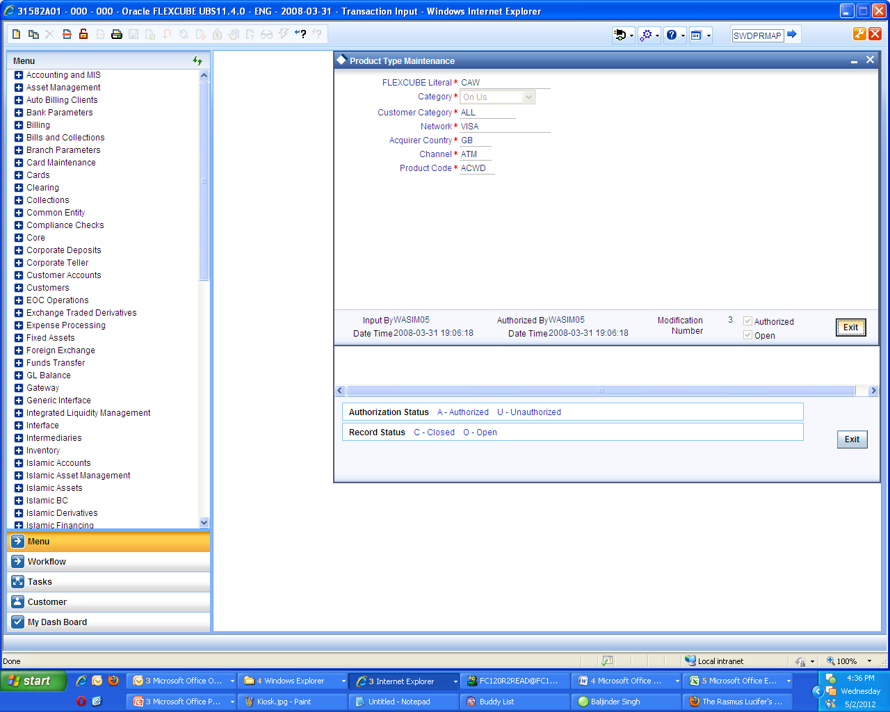
Interface Specific Maintenance – contd …
Product Type Maintenance
Product type maintenance screen is used to map the FLEXCUBE literals with the RT products maintained and the channels .
The following are the FLEXCUBE Literals :-
  CAW - Cash withdrawal
  BEQ - Balance enquiry
  CDP - Cash Deposit
  FTR - Fund transfer
  MST - Mini statement

Slide 52
Interface Specific Maintenance – contd …
Process Code Mapping
The Process code must have to be mapped with the respective channels with the help of the Process code mapping screen.
The following are the FLEXCUBE Literals :-
  31 – Balance Enquiry
  21 - Cash Deposit
  01 - Cash Withdrawal
  38 - Mini Statement generation
  00 - Normal Purchase(POS)
  91 - Cheque Book Request
  40 - Funds Transfer
  77 - Merchant File Settlement

Slide 53
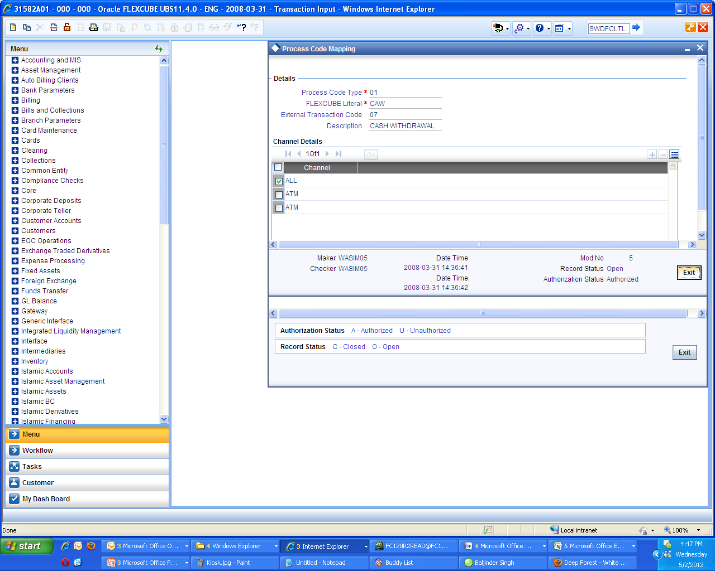
Interface Specific Maintenance – contd …
Process Code Mapping – contd…

Slide 54
SWITCH Software
Switch software functions in 2 layers,
As shown in the picture, In Layer1,
        Switch software maintains the terminals viz., ATM / POS interchange information.
        Maintains the card number to account number linkages.
        Verifies the PIN and the card status
        Receives card transactions from ATM / POS terminals
As part of Layer2,
        The switch software Forwards the transactions to Host Banking Systems like FLEXCUBE
        Converts the received proprietary protocol messages from the terminal into ISO8583 protocol.
        Performs “stand-in” authorization incase of Link to application systems is down.
        Refreshes Account balances from Banking Systems .

Slide 55
Transaction Supported in SWITCH
Transactions supported for ATM/IVR/POS
ATM | IVR | POS
Balance Enquiry | Balance Enquiry | Cash Back
Cheque Book Request | Cheque Book Request | Merchant File Statement
Adhoc Statement Request | Adhoc Statement Request | Merchant settlement
Mini Statement Request | Mini Statement Request | Normal Purchase
Funds Transfer | Funds Transfer | Purchase Adjustment
Cash Withdrawal
Cash Deposit

