Slide 1
Oracle Cloud Infrastructure Icon Set for Topologies and Diagrams
Quick Guide and Assets
Last updated 2.03.2019

Slide 2
Quick Guide: Introduction
Thank you for downloading Oracle Cloud Infrastructure Icon Set for topologies and diagrams.
The primary use of these icon is to create a unified visual language to illustrate topologies for Oracle’s Cloud products and services. The symbols, graphics, and connecting lines on the following pages will help you accurately communicate complex offerings, systems, ideas into an Oracle-branded diagram. Please read the following quick guide to get started.
This set is available in the following formats:
• EPS (for print) • SVG • PNG • Visio stencils • PPT

Slide 3
Quick Guide: Scaling and Colors
Maintain Proportions
Colors
Never alter the proportions of the icons. To resize, hold the shift key in most software programs to maintain the proportions while scaling up or down.
To ensure brand consistency and clarity in your diagrams, limit color usage to Oracle red, grey or white. Never use colors that are not in the Oracle corporate palette. Never use more than one color on a single icon.
To change color, click on icon and click on chosen fill color.
Or
Copy and paste icons in approved colors on pages 17-22.
Oracle Red
Dark Grey
SHIFT
+ Scale
Maintain Shape
White on Background Color
To ensure accurate and consistent use, never alter, rotate or embellish the icons. Do not use effects such as drop shadow or 3d on icons.
Do not rotate or flip
Do not embellish
Do not use unapproved colors
Do not use more than one color on a single icon
Do not add effects
Do not skew

Slide 4
Quick Guide: Groupings
Logical Groupings
Physical Resource Groupings
Groupings
Use these illustrations to the right when depicting groupings in your diagrams. Groupings are divided by logical and physical resource groupings and are indicated by dashed outlines and colors. Icons and captions are not mandatory but should be used if it add clarity and purpose to your diagram.
See page 7 for sample usage.
TENANCY
COMPARTMENT
REGION
AVAILABILITY DOMAIN
Logical Network Topologies
User Groupings
VCN
SUBNET
GROUPS
USERS

Slide 5
Quick Guide: Connectors
Connectors
Sample Connectors
Correct Usage with Icons and Groupings
Use connectors to connect icons to other icons or icons within different groupings. You may rotate or add additional connectors to your diagram.
Keep the width of the pegs consistent within your diagram for visual clarity.
Keep lines aligned and centered at each joint.
Keep a small gap between icon and connector for visual clarity.
Connectors should be kept in dark grey or match the icon colors.
See page 7 for sample usage.
Subnet A
10.0.30.0/24
Subnet B
10.0.30.0/24

Slide 6
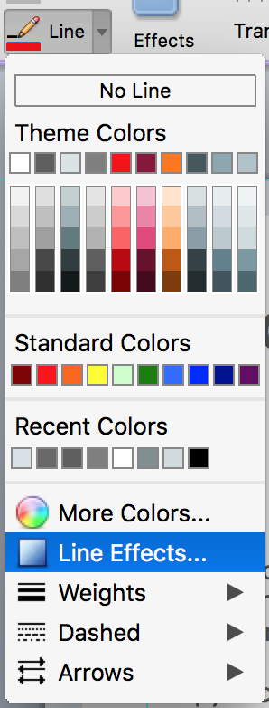
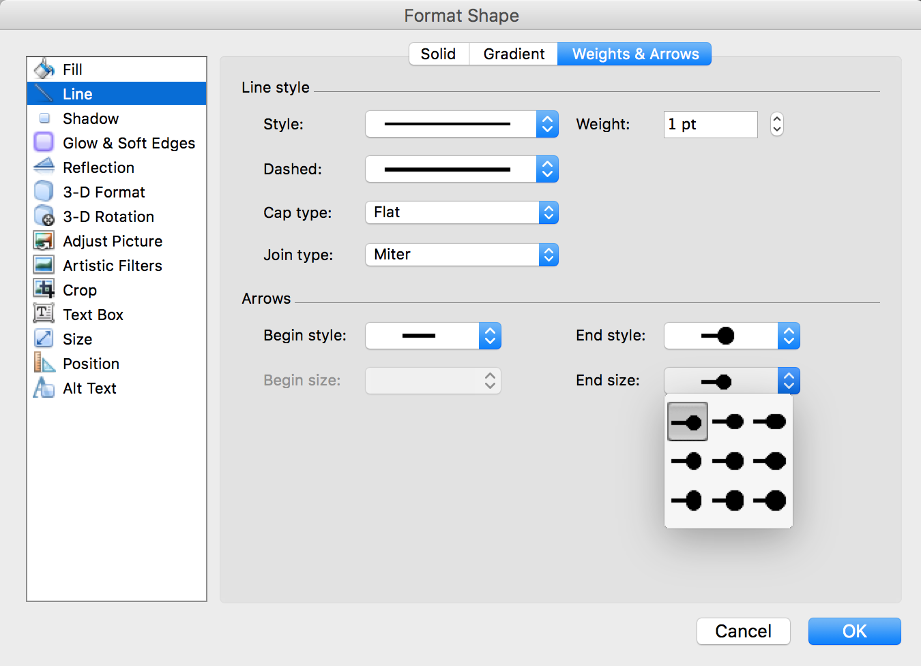
Quick Guide: Adjusting Connectors
Connectors
To adjust or recreate connectors go to the Format Shape panel under Line Effects and make adjustments in the Weights & Arrows panel.
Copy and paste from the sample connectors on page 5.

Slide 7
Sample Diagram: Icons, Groupings and Connectors
ORACLE CLOUD INFRASTRUCTURE (REGION)
Availability Domain 1
Availability Domain 2
AD3
Subnet A
10.0.30.0/24
Subnet D
10.0.30.0/24
Bastian Server
Loaded Balanced
Web Servers
Virtual Machine
ID & Access
Management
Bare Metal
Compute
VPN
Dynamic Routing Gateway
Virtual Machine
Subnet B
10.0.30.0/24
Subnet C
10.0.30.0/24
Primary Database
Standby Database
Auditing
Database System
Database System
Object Storage

Slide 8
Quick Guide: Captions
Using Captions
Thank You
The use of captions is not mandatory. If captions are needed, preferred placement is above or below icon.
Want to share your diagram? Post them here (link) to share with fellow engineers or marketers.
If you have comments or suggestions for improvement please send us a message here: (link to form)
Database System
Database System
Below Centered
Above Centered
Database System
Caption is editable and scalable to fit various layouts.
Avoid placing caption to the right or left of icon

Slide 9
OCI Icons – Red, Grey and White with Captions
Copyright © 2019, Oracle and/or its affiliates. All rights reserved. |

Slide 10
OCI Icons – Red with Captions – Group 1
Compute and Database
Storage
Connectivity
Bare Metal
Compute
Virtual Machine
Container
Database System
Block Storage
Object Storage
File Storage
FastConnect
Customer Premises
Equipment
Networking
Storage Gateway
Back Up/
Restore
Data Transfer
Customer
Data Center
VPN
Virtual Cloud
Network
Load Balancer
Firewall
Dynamic Routing Gateway
Buckets
Backbone
Service Gateway
Internet Gateway
Route Table
Security Lists
Edge
CDN
DNS
WAF
Email Delivery

Slide 11
OCI Icons – Red with Captions – Group 2
Security and Governance
Monitoring and Management
ID & Access
Management
Policies
Groups
Compartments
Queuing
Workflow
Notifications
Search
Alarming
Telemetry/ Monitoring
Oracle Cloud Identifier
Tagging
Auditing
DDoS Protection
Streaming
Logging
Healthcheck
Events
DevOps Tools and Services
Encryption
Key Management
API/Service
Resource
Manager

Slide 12
OCI Icons – Grey with Captions – Group 1
Compute and Database
Storage
Connectivity
Bare Metal
Compute
Virtual Machine
Container
Database System
Block Storage
Object Storage
File Storage
FastConnect
Customer Premises
Equipment
Networking
Storage Gateway
Back Up/
Restore
Data Transfer
Customer
Data Center
VPN
Virtual Cloud
Network
Load Balancer
Firewall
Dynamic Routing Gateway
Buckets
Backbone
Service Gateway
Internet Gateway
Route Table
Security Lists
Edge
CDN
DNS
WAF
Email Delivery

Slide 13
OCI Icons – Grey with Captions – Group 2
Security and Governance
Monitoring and Management
ID & Access
Management
Policies
Groups
Compartments
Queuing
Workflow
Notifications
Search
Alarming
Telemetry/ Monitoring
Oracle Cloud Identifier
Tagging
Auditing
DDoS Protection
Streaming
Logging
Healthcheck
Events
DevOps Tools and Services
Encryption
Key Management
API/Service
Resource
Manager

Slide 14
OCI Icons – White with Captions – Group 1
Compute and Database
Storage
Connectivity
Bare Metal
Compute
Virtual Machine
Container
Database System
Block Storage
Object Storage
File Storage
FastConnect
Customer Premises
Equipment
Networking
Storage Gateway
Back Up/
Restore
Data Transfer
Customer
Data Center
VPN
Virtual Cloud
Network
Load Balancer
Firewall
Dynamic Routing Gateway
Buckets
Backbone
Service Gateway
Internet Gateway
Route Table
Security Lists
Edge
CDN
DNS
WAF
Email Delivery
Copyright © 2019, Oracle and/or its affiliates. All rights reserved. |

Slide 15
OCI Icons – White with Captions – Group 2
Security and Governance
Monitoring and Management
ID & Access
Management
Policies
Groups
Compartments
Queuing
Workflow
Notifications
Search
Alarming
Telemetry/ Monitoring
Oracle Cloud Identifier
Tagging
Auditing
DDoS Protection
Streaming
Logging
Healthcheck
Events
DevOps Tools and Services
Encryption
Key Management
API/Service
Resource
Manager
Copyright © 2019, Oracle and/or its affiliates. All rights reserved. |

Slide 16
OCI Icons – Red, Grey and White
Copyright © 2019, Oracle and/or its affiliates. All rights reserved. |

Slide 17
OCI Icons – Red – Group 1
Compute and Database
Storage
Connectivity
Networking
Edge

Slide 18
OCI Icons – Red – Group 2
Security and Governance
Monitoring and Management
DevOps Tools and Services

Slide 19
OCI Icons – Grey – Group 1
Compute and Database
Storage
Connectivity
Networking
Edge

Slide 20
OCI Icons – Grey – Group 2
Security and Governance
Monitoring and Management
DevOps Tools and Services

Slide 21
OCI Icons – White – Group 1
Compute and Database
Storage
Connectivity
Networking
Edge
Copyright © 2019, Oracle and/or its affiliates. All rights reserved. |

Slide 22
OCI Icons – White – Group 2
Security and Governance
Monitoring and Management
DevOps Tools and Services
Copyright © 2019, Oracle and/or its affiliates. All rights reserved. |

